Slide 1



Health Care and Healing Practitioners
and the Law
2025
Diane M. Miller JD
Law and Public Policy Advisor
National Health Freedom Coalition
NHFC and NHFA
PMB 218, 2136 Ford Parkway, St. Paul, MN 55116-1863
Unites States of America
www.nationalhealthfreedom.org
E-mail: info@nationalhealthfreedom.org

Slide 2
Where do people turn
when they need healing?
Seeking trusted sources

Slide 3
Family
Friends
Community trusted healer

Slide 4
Experts
pharmaceutical and surgical medicine
market-dominant

Slide 5
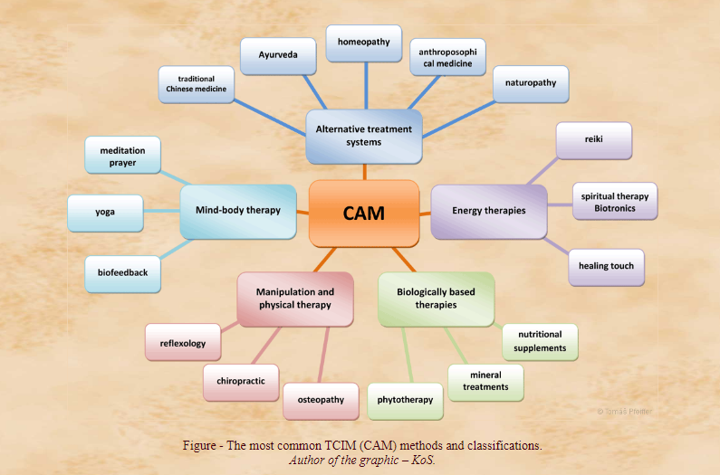
Graphic used with permission of ITCIM https://www.itcim.org/about-us

Slide 6
Bias and Suppression
in cultures and in marketplaces

Slide 7
Healing as an Art
Healing as Science
HEALING AS LAW!

Slide 8
CONSTITUTION
Law of the Land
Authority to make and enforce laws

Slide 9
US Constitutional Law
First Amendment: Congress shall make no law respecting an establishment of religion, or prohibiting the free exercise thereof; or abridging the freedom of speech, or of the press; or the right of the people peaceably to assemble, and to petition the Government for a redress of grievances.
“Type a quote here.”
–Johnny Appleseed

Slide 10
Look to the Law
Why are TCIM practitioners and products
Shut down? Ignored? Vilified?
“Type a quote here.”
–Johnny Appleseed

Slide 11
Some Laws that Impact Healing
Constitutional Law Protecting Personal Freedoms
Federal Product Law
Federal and State Emergency Health Powers
Federal Agency Law FDA CDC etc.
State Occupational Licensing Boards and Agencies
State Civil Law for Damages
State and Federal Criminal Laws
“Type a quote here.”
–Johnny Appleseed

Slide 12
  Occupations: Practitioners
  Commerce: Products
  Personal Freedoms: Right to Refuse

Slide 13
Occupation Law

Slide 14
Who Can Practice the Healing Arts
in your locality?
Practice of Medicine Defined
…(3) Offers or undertakes to prevent or diagnose, correct or treat by any means, methods, devices, or instrumentalities, any disease, illness, pain, wound, fracture, infirmity, deformity, or defect of any person…
Unlicensed = Gross misdemeanor
MN Stat 147
“Type a quote here.”
–Johnny Appleseed

Slide 15
Exemptions to State Licensing Law
…(11) A Christian Scientist or other person who endeavors to prevent or cure disease or suffering exclusively by mental or a spiritual means or by prayer.”…
  (15) An unlicensed complementary and alternative health care practitioner practicing according to chapter 146A.
Minnesota Statute 147.019
“Type a quote here.”
–Johnny Appleseed

Slide 16
2000 EXEMPTION: MN 146A
Complementary and Alternative Practices
include but are not limited to:
(1) acupressure; (2) anthroposophy; (3) aroma therapy; (4) ayurveda; (5) cranial sacral therapy; (6) culturally traditional healing practices; (7) detoxification practices and therapies; (8) energetic healing; (9)polarity therapy; (10) folk practices; (11) healing practices utilizing food, food supplements, nutrients, and the physical forces of heat, cold, water, touch, and light; (12) Gerson therapy and colostrum therapy; (13) healing touch; (14) herbology or herbalism; (15) homeopathy; (16) nondiagnostic iridology; (17) body work, massage, and massage therapy; (18) meditation; (19) mind-body healing practices; (20) naturopathy; (21) noninvasive instrumentalities; and (22) traditional Oriental practices, such as Qi Gong energy healing.
Minnesota Statute 147.019
“Type a quote here.”
–Johnny Appleseed

Slide 17
Licensed Practitioners
“Type a quote here.”
Unique Privilege
Unique Restrictions
–Johnny Appleseed

Slide 18
Delegation of Authority to
Executive Boards
Definition of the Occupation – scope
Required Education and Exams
Authority to Enforce Occupation Law
Grounds for Disciplinary Action
Violation for Unlicensed Practice
Exemptions from Criminal Charges
“Type a quote here.”
–Johnny Appleseed

Slide 19
Licensed Practitioners
LOSS OF LICENSE
“Type a quote here.”
Grounds for Disciplinary Actions
–Johnny Appleseed

Slide 20
Grounds for Disciplinary Action
Minnesota
Medical Doctors Minnesota
“…. Unprofessional conduct shall include any departure from or the failure to conform to the minimal standards of acceptable and prevailing medical practice in which proceeding actual injury to a patient need not be established…”
Minnesota Statute 147.091
“Type a quote here.”
–Johnny Appleseed

Slide 21
Expanded Practice Model Law
“Type a quote here.”
Safe Harbor for Licensed Practitioners practicing outside of the conventional standard of care.
–Johnny Appleseed

Slide 22
MODEL EXPANDED HEALTH CARE
PRACTICE ACT
“Type a quote here.”
“3 principles to practice outside of the conventional standards of care”
–Johnny Appleseed

Slide 23
MODEL EXPANDED HEALTH CARE
PRACTICE ACT
“Type a quote here.”
1. Services that do not pose a greater risk of direct physical or emotional harm to a patient/client when used as directed than that of conventional predominantly used treatment.
–Johnny Appleseed

Slide 24
MODEL EXPANDED HEALTH CARE
PRACTICE ACT
2. Provide with reasonable skill and safety according to the practitioner’s knowledge, education, experience, or training in the expanded health care practice or service.
“Type a quote here.”
–Johnny Appleseed

Slide 25
MODEL EXPANDED HEALTH CARE
PRACTICE ACT
3. Expanded disclosures.
a. Theoretical approach
b. Special education and training
c. Standard legal informed consent
d. Written acknowledgement
“Type a quote here.”
–Johnny Appleseed

Slide 26
Product Law

Slide 27
Federal Law : Food and Drug Administration (FDA) Definition of Drug
The term “drug” means
articles recognized in the official United States Pharmacopoeia, official Homeopathic Pharmacopoeia of the United States, or official national Formulary, or any supplement to any of them; and
(B) articles intended for use in the diagnosis, cure, mitigation, treatment, or prevention of disease in man or other animals; and
(C ) articles (other than food) intended to affect the structure or any function of the body of man or other animals; and
(D) articles intended for use as a component of any article specified in Clauses (A), (B) or (C) of this paragraph. A food or dietary supplement for which a claim ….”.
21 U.S.C. 321(g)1
“Type a quote here.”
–Johnny Appleseed

Slide 28
Homeopathic Remedies
How are homeopathic products regulated by the federal government?
“Type a quote here.”
Drugs or Food?
–Johnny Appleseed
Drugs!

Slide 29
Status of Homeopathic Remedies
Unapproved Drugs
“Under the Federal Food, Drug, and Cosmetic Act, homeopathic products are subject to the same requirements related to approval, adulteration and misbranding as other drug products. There are currently no homeopathic products approved by FDA.”
“Type a quote here.”
–Johnny Appleseed
FDA Website September 23, 2020

Slide 30
Dietary Supplements
How are Vitamins, Minerals, Amino Acids, Herbs and many other dietary substances regulated by the federal government?
“Type a quote here.”
Drugs or Food?
–Johnny Appleseed
Food!

Slide 31
US Status of Dietary Supplements
“Type a quote here.”
Generally Regarded as Safe (GRAS)
Burden of Proof on government to show harm before restricting.
–Johnny Appleseed

Slide 32
Burden of Proof on Government NEEDED
“Type a quote here.”
The burden of proof needs to be on the government to show harm by clear and convincing evidence before restricting products, or practitioners.
–Johnny Appleseed

Slide 33
NHFC Designs
Legislation for the Future
Long and Short Versions of potential bills, are often designed by NHFC staff attorneys for consideration of groups interested in helping pass laws.
“Type a quote here.”
–Johnny Appleseed

Slide 34
Personal Freedom

Slide 35
Personal Freedom
Refusal of treatment. Notwithstanding laws, rules, or orders made or promulgated in response to a national security emergency or peacetime emergency, individuals have a fundamental right to refuse medical treatment, testing, physical or mental examination, vaccination, participation in experimental procedures and protocols, collection of specimens, and preventive treatment programs.
MN Stat 12.39
“Type a quote here.”
–Johnny Appleseed

Slide 36
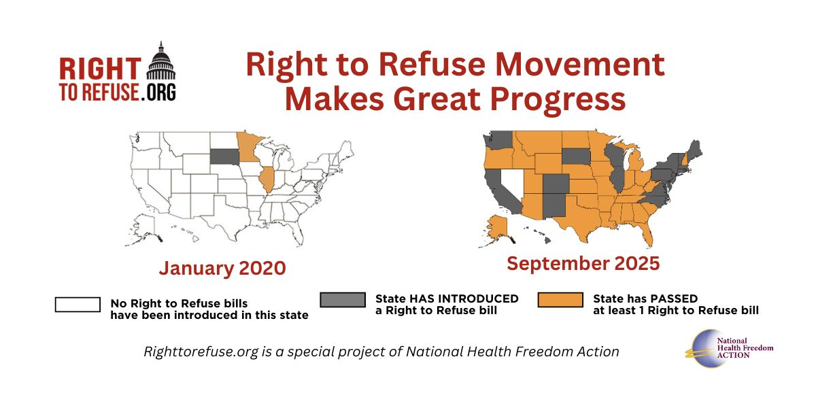
–Johnny Appleseed
“Type a quote here.”

Slide 37
Right to Refuse and Personal Freedom
1,500+ Right to Refuse bills filed since 2020
49 States have filed at least one Right to Refuse bill
93 Right to Refuse Bills have passed into law in 29 states!
“Type a quote here.”
–Johnny Appleseed

Slide 38
People Make Laws
If we care about what laws say, and we are in a country or community where we have the opportunity to make laws, then we can design the future to reflect our visions!
-Diane Miller
“Type a quote here.”
–Johnny Appleseed

Slide 39
Be an Agent of Change
Laws and customs must be carefully reviewed, revised, and even repealed if necessary, and new laws created, to reflect the development, evolution, and spiritual maturation of a people.
-Diane Miller
“Type a quote here.”
–Johnny Appleseed

Slide 40


PMB 218, 2136 Ford Parkway, St. Paul, MN 55116-1863
www.nationalhealthfreedom.org
E-mail: info@nationalhealthfreedom.org

