Slide 1
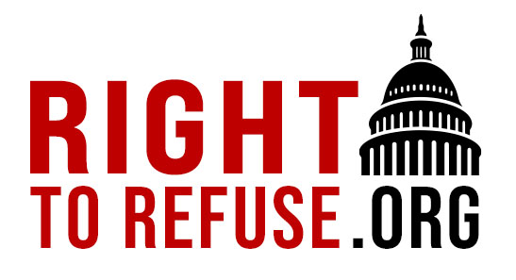
Right to Refuse
Legislation Update and More!
September 6, 2023
Steven O’Connor JD Staff Attorney
National Health Freedom Coalition
NHFC and NHFA
PMB 218, 2136 Ford Parkway, St. Paul, MN 55116-1863
www.nationalhealthfreedom.org
E-mail: info@nationalhealthfreedom.org

Slide 2
Right to Refuse: New Laws in 2023
Since 2020, the Right to Refuse project has kept folks up to date on new laws designed to protect our ability to choose whether or not to receive a medical intervention. In this time, we have reviewed over 3,000 bills and tracked 1,076 which would protect our rights. To date, 29 states have passed 84 Right to Refuse bills. Here is a recap of the 13 bills that have passed this year
Manufacturing, Selling, Marketing or
Making Health Claims of Homeopathic Remedies

Slide 3
Bills Passed January-August 2023
Hospital Visitors’ Rights
No hospital/facility visitor precautions which are more stringent than those required for staff. Visitors may not be excluded based on vaccine status. Idaho HB244
No hospital/facility visitor precautions which are more stringent than those required for staff. Facilities may not require proof of vaccination from visitors. Physical contact with patients allowed. Louisiana HB291

Slide 4
Youth and Parent Protection
No COVID-19 vaccine mandates for preK-12 and postsecondary schools prior to July 1, 2029. Iowa HF2298
Vaccine status of parents or children may not be admitted into evidence in proceedings involving child custody or parental rights. Montana HB684
Prohibits investigations and court orders terminating a parent's relationship with their child based on the child's immunization status. Idaho SB1029
Childcare facilities shall notify parents of right to object for any reason to vaccine requirements. Idaho SB1005

Slide 5
Death Certificates to Show Vaccine Status; Medicaid Protection
Death certificates to include vaccination status; health facilities cannot mandate employer COVID-19 vaccine; hospitals may not deny treatment based on COVID-19 vaccine status. North Dakota HB1502
Prohibits discrimination against a Medicaid recipient or child health plan program enrollee based on immunization status. Texas HB44

Slide 6
Broad Right to Refuse Protections
Businesses and government entities may not require COVID-19 testing for services or employment; employers may not discriminate based on COVID-19 vaccine status, immunity, or testing. Florida SB252
Public accommodations and employers may not discriminate based on vaccine status; government entities may not require any vaccine.
Utah HB131

Slide 7
Businesses may not refuse service based on COVID-19 vaccine status, require an employee to get such a vaccination with exemptions; state entity may not condition services based on COVID-19 vaccine status. Idaho SB1130
Unlawful to discriminate in employment, public accommodations, or public services based on immunity passport. Exceptions include vaccines required by Medicare
North Dakota SB2274
Government entity may not mandate: face masks to prevent spread of COVID-19, vaccination against COVID-19, or business and school closures. Texas SB29

Slide 8
But wait, there’s more!

Slide 9
Court of Appeals: FDA Went Beyond its Legal Mandate in its’ anti-Ivermectin Campaign; Agency Implied Drug only for Animals
On Friday September 1, the 5th US Circuit Court of Appeals in New Orleans ruled in favor of three doctors who say that FDA overstepped its legal mandate with its anti-ivermectin information campaign. The appeals court brought the case back to life after a lower court ruling in favor of the FDA. While ivermectin is used for livestock, it is also a Nobel prize winning human drug on WHO’s list of essential medications. The physicians included Paul E. Marik of the Front Line COVID-19 Critical Care Alliance (FLCCC).

Slide 10
“FDA is not a physician. It has authority to inform, announce, and apprise—but not to endorse, denounce, or advise,” the court opined. “The Doctors have plausibly alleged that FDA’s Posts fell on the wrong side of the line between telling about and telling to.” (Italics added.)
The court noted that FDA was arguing that it wasn’t really recommending against ivermectin. Yet, “this approach assumes that the Posts contain only factual statements and information, and that they do not contain any medical recommendations or advice.”
The judge offers that all of the posts at issue have syntax which is imperative and not declaratory: e.g., “Stop it,” “Stop it with the #ivermectin,” and “Q: Should I take ivermectin to prevent or treat COVID-19? A: No.”
FLCCC’s arguments for using this drug are online here.

Slide 11
Masks Return

Slide 12
“Will Covid Mask Mandates Return? Here’s Where They’re Making A Comeback” Forbes, September 2, 2023 “Wearing masks in the community probably makes little or no difference to the outcome of influenza‐like illness/COVID‐19-like illness compared to not wearing masks.” Cochran Review, January 2023, Large-Scale Meta-Analysis

