Slide 1
Right to Refuse
New Bills and Beyond
November 29, 2023
Steven O’Connor JD Staff Attorney
National Health Freedom Coalition
NHFC and NHFA
PMB 218, 2136 Ford Parkway, St. Paul, MN 55116-1863
www.nationalhealthfreedom.org
E-mail: info@nationalhealthfreedom.org

Slide 2
New Bills October-November 2023:
Texas leads the way…
Manufacturing, Selling, Marketing or
Making Health Claims of Homeopathic Remedies

Slide 3
Texas hard at work for health freedom!

Slide 4
Passed! Texas SB7:
Private employers may not mandate COVID-19 vaccination for employees. Remedies and other provisions.
Signed November 10, effective February 6, 2024
What Remedies?
ADMINISTRATIVE PENALTY
$50,000 per violation, unless make “every reasonable effort” to compensate employees who faced a mandate with back pay, etc.

Slide 5
Texas SB41:
No discrimination in public accommodations, health facilities or care, insurance, or employment based on COVID-19 vaccine status. Remedies.
Filed, Received by the Secretary of the Senate 10/09/2023.

Slide 6
Texas HB91:
No person may compel another to receive a COVID-19 vaccine if receiving the vaccine is contrary to the individual ’s vaccination preference. No COVID-19 vaccination without informed consent. Health care facility workers are exempted based on religious belief or medical condition. Remedies.
Filed 10/9/23.

Slide 7
Texas HB49:
Individuals have the right to keep vaccine status private and may not be required to disclose this to employer, unless disclosure is required by state or federal law. Remedies.
Filed 11/7/23.

Slide 8
Texas HB35:
Texas COVID-19 Vaccine Freedom Act.
No person may compel or coerce an individual to obtain any COVID-19 vaccine contrary to the individual’s preference. No provider may administer a COVID-19 vaccine without informed consent, and if coercion used capacity to consent is vitiated. No person may take adverse action against an individual who declines a COVID-19 vaccine.
Filed 11/7/23.

Slide 9
Texas HB34:
Employers may not mandate COVID-19 vaccine for any reason, nor take any adverse action based on refusal of said vaccine. Remedies.
Filed 11/7/23 SO.

Slide 11
Wisconsin AB610:
Vaccine requirements for institutions of higher education shall be waived if student objects for reasons of health, religion, or personal conviction. No further justification or explanation may be required.
10/31/2023 Introduced; Read first time and referred to Committee on Colleges and Universities.

Slide 12
Wisconsin AB612:
Any employer who requires a vaccination shall waive such requirements if the employee objects to the immunization for reasons of health, religion, or personal conviction. No further explanation or justification may be required. Employer to notify employees of the right to object.
10/31/2023 Introduced; Read first time and referred to Committee on Labor and Integrated Employment. 11/16/2023 Public hearing held.

Slide 13
Wisconsin AB510/SB489:
Broad parents’ rights bill. Includes the right to be notified of each health care service, including vaccinations or immunizations, offered at the child's school and the right to withhold consent or decline any specific service, unless otherwise specified by law or court order.
10/18/2023 Introduced; Read first time and referred to Committee on Family Law.

Slide 14
Michigan HB5202:
Amends consumer protection act to include pharmaceuticals; failure, on the part of a manufacturer or producer, to accurately represent the risks involved in the use of a prescription, over-the-counter drug, medication, herbal product, dietary supplement, or botanical extract is in violation of act.
10/24/2023 introduced; referred to Committee on Regulatory Reform.

Slide 15
Ohio HB319:
Conscientious Right to Refuse Act. Businesses, employers, health care providers, institutions of higher education, government entities, and others may not discriminate in listed actions based on refusal of any pharmaceutical product for reasons of conscience, including religious convictions.
11-8-2023 Introduced. 11-14-2023 Referred to committee Health Provider Services.

Slide 16
We’ve got Lawsuits!

Slide 17
Advocates for Faith and Freedom:
“In October 2023, a lawsuit was filed by Advocates for Faith and Freedom to challenge California SB 277, which restricts religious exemptions for childhood vaccinations. Their lawsuit alleges this legislation violates the constitutional rights of parents to make medical decisions for their children. Advocates for Faith and Freedom is challenging the constitutionality of this legislation, seeking to restore the ability for parents and students to lodge a religious objection for those with sincerely held beliefs. It is likely this matter will ultimately be required to go before the U.S. Supreme Court…

Slide 18
CA SB277 continued…
“California Senate Bill 277 (SB277) eliminated nonmedical exemptions from state-mandated immunizations for children entering public or private schools. The bill applies to children enrolled in private or public elementary or secondary schools, daycare centers, and public or private daycares and preschools. SB 277 was signed by Governor Jerry Brown in June 2015 and became effective on January 1, 2016. California was the first state in nearly 35 years to take this step.”

Slide 19
McMahon et al. v. City of Los Angeles
A complaint for damages, filed Nov. 17, 2023 against the City of Los Angeles alleging civil rights violations under 42 USC 1983 and the 14th Amendment for the City’s Ordinance 187134 requiring submission to “Covid vaccination” as a condition of remaining employed with the City. This mandate remains in effect to this day.
The plaintiffs are 56 individuals who either (1) refused the EUA investigational drug and suffered adverse employment action such as termination, suspension, etc., or (2) accepted the coerced EUA investigational drug in order to keep their employment with the City.

Slide 20
Richardson v. NBA
Amended Complaint filed November 1, 2023
Attorney Steven M. Warshawsky:
“Here is an amended complaint (sans exhibits) that I filed today for an NBA ref who was fired after his RE was denied because his beliefs are allegedly ‘political’ - the plaintiff is a devout born again Christian who is quite well versed in the Book of Revelations and believes that covid and the vax are part of Satan’s machinations to install a one world government under his power. The plaintiff is much more learned and eloquent than I am on this issue. (He approved my posting the amended complaint.)
The point is, because he referred to a ‘one world government,’ the NBA decided his objections to the vax were “political” and not religious.”

Slide 21
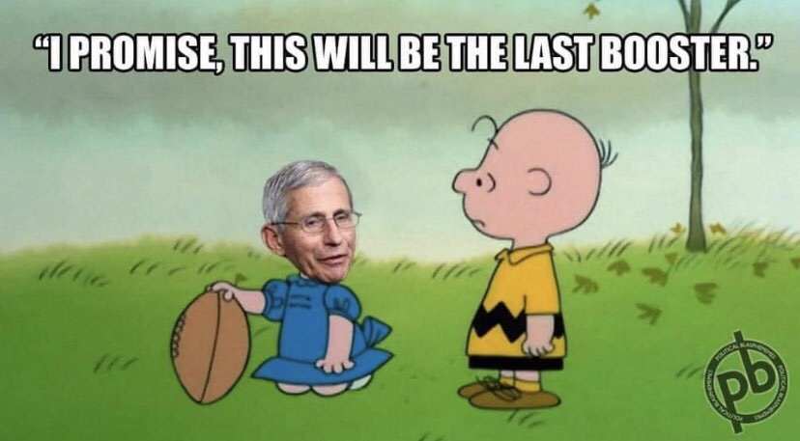
Meme of the Day

