Slide 1
The Fundamental Constitutional Right to Make Ones Own Health Decisions Is a Matter of Survival
Diane M. Miller JD Director of Law and Public Policy
National Health Freedom Coalition
November 3, 2020

Slide 2
National Health Freedom Coalition a non-profit educational organization www.nationalhealthfreedom.org
National Health Freedom Action a non-profit lobbying organization
www.nationalhealthfreedomaction.org

Slide 3
Freedom to Live, Heal, and Survive

Slide 4
HEALTH FREEDOM
Health freedom is the internal and intentional steering mechanism within a person and within a community that guides us in life and death decisions. It is the freedom to make decisions for oneself and one’s community about survival and health. It is rooted in the naturally occurring drive and commitment within people to keep themselves and their loved ones alive. Health freedom is a fundamental natural right of survival and personal sovereignty.

Slide 5
The Power of Law In America
The Voice of Freedom

Slide 6
Will concentrations of power and money and the owners of technology dominate and replace our government? Will the government of the people, by the people, and for the people perish from this earth?

Slide 7
The American constitutional system needs to work to safeguard American liberties and health freedoms as governments and corporations grow and technology advances.

Slide 8
When Health Freedom is in Jeopardy NHFA Helps Citizens Pass Laws to Protect Health Freedom
- Attorney Staff
- Research and Draft Laws
- Strategic Conference calls
- Lobbying Training
- Travel and Presentations
- Testimony
- Send Citizen Alerts to Lawmakers and Authorities

Slide 9
State of Minnesota Practice of Medicine Defined
(3) offers or undertakes to prevent or to diagnose, correct, or treat in any manner or by any means, methods, devices, or instrumentalities, any disease, illness, pain, wound, fracture, infirmity, deformity or defect of any person;
MN 147.081 Gross Misdemeanor

Slide 10
EXEMPTION: MN 146A Complementary and Alternative Practices include but are not limited to:
(1) acupressure; (2) anthroposophy; (3) aroma therapy; (4) ayurveda; (5) cranial sacral therapy; (6) culturally traditional healing practices; (7) detoxification practices and therapies; (8) energetic healing; (9)polarity therapy; (10) folk practices; (11) healing practices utilizing food, food supplements, nutrients, and the physical forces of heat, cold, water, touch, and light; (12) Gerson therapy and colostrum therapy; (13) healing touch; (14) herbology or herbalism; (15) homeopathy; (16) nondiagnostic iridology; (17) body work, massage, and massage therapy; (18) meditation; (19) mind-body healing practices; (20) naturopathy; (21) noninvasive instrumentalities; and (22) traditional Oriental practices, such as Qi Gong energy healing.

Slide 11
There are State Health Freedom Groups Working on Many Issues
Practitioner Rights to Practice
Vaccine Exemption Rights
GMO Labeling
Electromagnetic Frequency
Glyphosates Roundup Impact
Regenerative Projects
Mercury and Fluoride Toxicity

Slide 13
2020
State Governor Emergency Orders
Stay at Home
Lose Your Job
Social Distance
Wear a Mask

Slide 14
2020
Can Governors Do That?

Slide 15
State Law
Police Power
Federal Law
Commerce

Slide 16
State Laws – Police Power
1. Constitution
2. State Statutes
3. Administrative Regulations
4. Governor Executive Orders
Notes:
Broad definitions
Good for the profession because gives them great latitude in treating
Describes many tools that they have

Slide 17
State Constitution MN
Minnesota’s government was instituted “for the security, benefit and protection of the people, in whom all political power is inherent…”.
Minnesota State Constitution Article I, Section 1., Adopted October 13, 1857,
Generally Revised November 5, 1974, accessed online June 13, 2020 @ https://www.revisor.mn.gov/constitution/#article_1
Notes:
Broad definitions
Good for the profession because gives them great latitude in treating
Describes many tools that they have

Slide 18
State Statutes
State Lawmakers pass laws:
Including laws that delegate authority to Governors for emergency management.
Notes:
Broad definitions
Good for the profession because gives them great latitude in treating
Describes many tools that they have

Slide 19
Example State Statute
MN Stat 12.21 GOVERNOR. §Subdivision 1.General authority.
The governor (1) has general direction and control of emergency management, (2) may carry out the provisions of this chapter, and (3) during a national security emergency declared as existing under section 12.31, during the existence of an energy supply emergency as declared under section 216C.15, or during the existence of an emergency resulting from an incident at a nuclear power plant that poses a radiological or other health hazard, may assume direct operational control over all or any part of the emergency management functions within this state
Notes:
Broad definitions
Good for the profession because gives them great latitude in treating
Describes many tools that they have

Slide 20
State Statutes For Emergency Declarations
MN Law NOW: A peacetime declaration of emergency may be declared only when an act of nature, a technological failure or malfunction, a terrorist incident, an industrial accident, a hazardous materials accident, or a civil disturbance endangers life and property and local government resources are inadequate to handle the situation
Notes:
Broad definitions
Good for the profession because gives them great latitude in treating
Describes many tools that they have

Slide 21
Model State Emergency Health Powers Acts
In 2002 Many states passed what at the time was called the "Model State Emergency Health Powers Act." MEHPA.
ACLU stated that it was drafted as “model legislation to increase state powers to respond to bioterrorism or other outbreaks of disease that the Centers for Disease Control and others want the states to pass into law. Although such legislation is needed, the current draft of the Model Act unfortunately is written in a way that doesn't adequately protect citizens against the misuse of the tremendous powers that it would grant in an emergency.”
ACLU, Q and A on the Model State Health Emergency Powers Act accessed online June 13, 2020 @ https://www.aclu.org/other/model-state-emergency-health-powers-act
Notes:
Broad definitions
Good for the profession because gives them great latitude in treating
Describes many tools that they have

Slide 22
Minnesota’s 2002 Right to Refuse
12.39 INDIVIDUAL TREATMENT; NOTICE, REFUSAL, CONSEQUENCE.
Subdivision 1. Refusal of treatment. Notwithstanding laws, rules, or orders made or promulgated in response to a national security emergency or peacetime emergency, individuals have a fundamental right to refuse medical treatment, testing, physical or mental examination, vaccination, participation in experimental procedures and protocols, collection of specimens, and preventive treatment programs. An individual who has been directed by the commissioner of health to submit to medical procedures and protocols because the individual is infected with or reasonably believed by the commissioner of health to be infected with or exposed to a toxic agent that can be transferred to another individual or a communicable disease, and the agent or communicable disease is the basis for which the national security emergency or peacetime emergency was declared, and who refuses to submit to them may be ordered by the commissioner to be placed in isolation or quarantine according to parameters set forth in sections 144.419 and 144.4195.

Slide 23
California Emergency Law
California Statute Health and Safety Code Section 120140. Upon being informed by a health officer of any contagious, infectious, or communicable disease the department may take measures as are necessary to ascertain the nature of the disease and prevent its spread. To that end, the department may, if it considers it proper, take possession or control of the body of any living person, or the corpse of any deceased person.
California Health and Safety Code Section 120140, accessed online June 13, 2020, @ http://leginfo.legislature.ca.gov/faces/codes_displaySection.xhtml?lawCode=HSC&sectionNum=120140.
Notes:
Broad definitions
Good for the profession because gives them great latitude in treating
Describes many tools that they have

Slide 24
2020 COVID STATE POLICE POWER CHALLENGED

Slide 25
Governor Powers Challenged in Wisconsin
May 13, 2020: The Supreme Court of Wisconsin overturned its Governor’s stay-at-home order with judicial comments reflecting that expansive Governor orders cannot go beyond the constitutional inalienable rights of citizens, even in the case of declared emergencies. “It is especially in times of emergency that we must protect the rights of the people, lest we establish a dangerous precedent empowering less benevolent government officials in the future to oppress the people in the name of exigency.” .
Wisconsin Legislature v. Secretary of Wisconsin Department of Health Services, 2020 Wis. 42 (May 13, 2020) (4-3 decision) (quoting Grassl Bradley, J., concurring), accessed online June 13, 2020 @ https://nationalhealthfreedomaction.org/wp-content/uploads/2020/05/Corona-Virus-Supreme-Court-Wisconsin.pdf

Slide 26
Governor Powers Challenged Pennsylvania
September 14, 2020, the federal Court for the Western District of Pennsylvania, declared the Pennsylvania Executive Orders on (1) restrictions on gatherings and (2) closing “non-life sustaining” businesses and directing Pennsylvanians to stay-at-home unconstitutional. The federal cited Jacobson v. Massachusetts, 197 U.S. 11, 31 (1905) to discuss when and when not to give broad deference to state government during emergencies and to show how Courts have evolved over time in the past 100 years since the Jacobson case to be more vigilant in the protection of civil liberties and the need to apply regular constitutional scrutiny when civil liberties are at stake.

Slide 27
Governor Powers Challenged in Michigan
On October 2, 2020, The Supreme Court of the State of Michigan issued an opinion declaring the Michigan EPGA (Emergency Powers of the Governor Act) unconstitutional. The Court’s conclusion was based on the fact that the law “purports to delegate to the executive branch, the legislative powers of state government—including its plenary police powers—and to allow the exercise of such powers indefinitely.” [i]
The high Court said the scope of the law and the expansiveness of the authority it concentrates in a single public official was “extraordinary”.

Slide 28
2020 California’s Draft Legislation Right to Refuse
(b) Coercion. The government or its designees, or other employers, businesses, non-profits, institutions, churches, travel carriers, or other public or private entities, may not infringe upon, put conditions on, restrict, or take away a person’s ability to fully participate in necessary and important services and lifestyle choices and preferences including but not limited to education, daycare, employment, travel, religion, hobbies, entertainment, sports, and lifestyle preferences, based on a person choosing to decline countermeasures as described in part (a).

Slide 29
2020 CHCA California’s Draft Legislation Right to Refuse
Countermeasures to Refuse.
medical treatments or procedures; testing; physical or mental examination; vaccination; experimental procedures and protocols; collection of specimens; participation in tracking or tracing programs; the wearing of masks; the maintaining of measured distance from other humans and animals that is not otherwise unlawful; and the involuntary sharing of personal data or medical information.

Slide 30
2020 COVID FEDERAL POWER
Travel Restrictions
Interstate Commerce
Access to Products
Individual Unemployment Relief
Individual Financial Relief
Funds to State Public Health Emergencies
Much More

Slide 31
NHFA STATE FOCUS
Work in the states to curb police power
And protect personal liberties

Slide 32
What You Can Do In Your State or Place!
- Uphold the Constitution
- Find Like Minded People Taking Action
- Decide What You are Willing to Resist
- Support Legal Court Challenges
Together
- Target the Source of Declared Authority
- Design a Solution for the Future
- Introduce and Pass Laws and Ordinances

Slide 33
Wisconsin Leaders at the Capitol

Slide 34
Massachusetts Leaders at the Capitol

Slide 35
Safe Harbor Maine at the Capitol

Slide 36
How to Pass a Bill in Your State
www.nationalhealthfreedomaction.org
NHFA Attorneys to Help Guide
- Conference calls
- Presentations
- Drafting
- Testimony

Slide 37
WHO is representing YOU?
We need to be at the table long term if we plan to make a difference and protect health freedom.

Slide 38
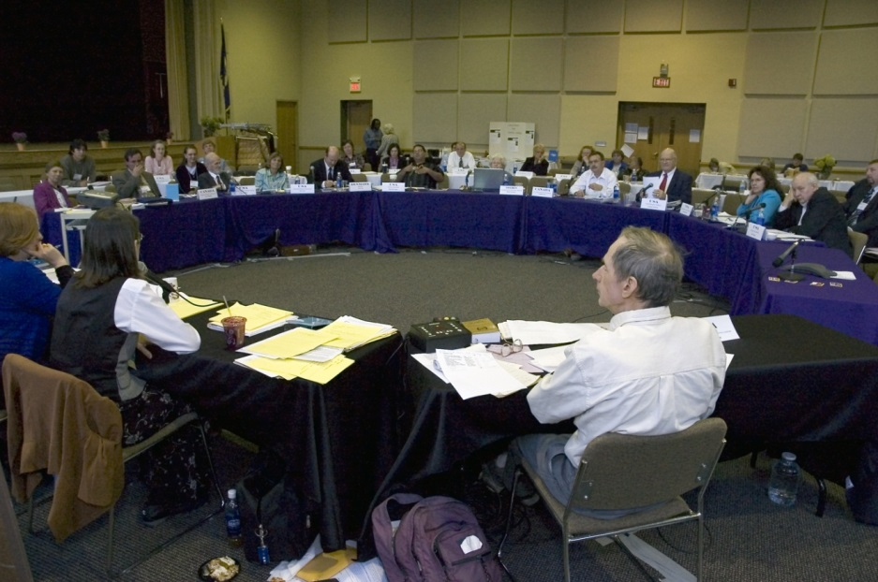
U.S. Health Freedom Congress
Voting Members

Slide 39
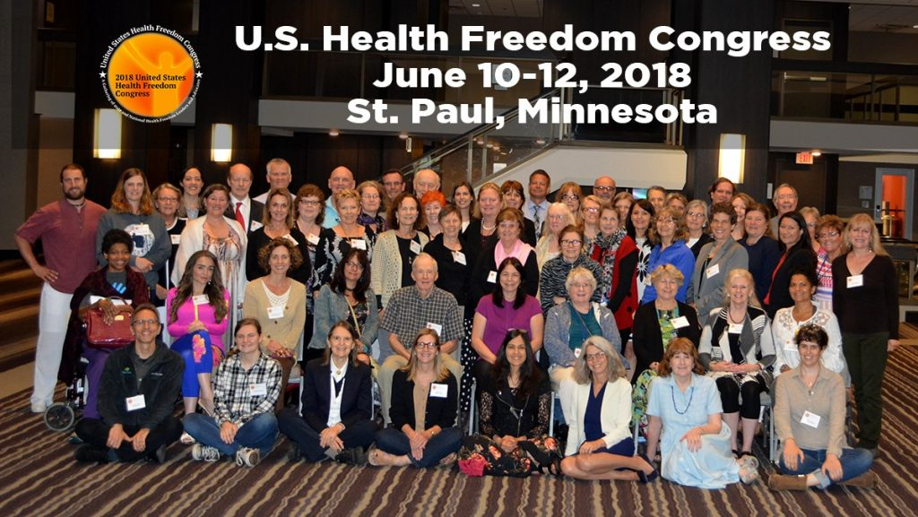

Slide 40
Principles of Health Freedom

Slide 41
Principle #1. The fundamental right of self-determination of individuals, to be let alone to survive on their own terms and in their own manner.

Slide 42
Principle #2. The freedom to perceive and to act as one wishes to secure health and survival.

Slide 43
Principle #3 The freedom to access who and what one needs or prefers for ones health and survival.

Slide 44
Principle #4 The responsibility to do no harm.

Slide 45
Principle #5 The responsibility to respectfully tolerate diverse options in health, healing, and survival choices.

Slide 46
Principle #6 The duty of corporations and institutions to be trustworthy entities upholding health freedom rights and liberties of members of the human family, and abiding by health freedom responsibilities.

Slide 47
Principle #7 And in light of the special legal nature of corporate entities and their systemic impact on the human family, the duty to:

Slide 48
#7-1 -honor and preserve the sovereign nature of individuals, the sovereignty of the United States; and avoid any negative impact on the sovereignty of other nation states;

Slide 49
#7-2 -honor and preserve American financial and cultural diversity and multicultural systems, and avoid negative financial or cultural impacts on other nation states;

Slide 50
#7-3 -avoid creating or being monopolies, and avoid the use of large monopolistic ownership of resources to dominate cultures, public policies, regulations and laws;

Slide 51
#7-4 -avoid dominant control of natural resources, avoid the suppression of access to natural resources, and avoid potentially harmful modification or destruction of natural resources; and

Slide 52
#7-5 -avoid promotion of products, protocols, policies, regulations, or laws, that would encourage unlimited dependence on corporations and institutions, or that would discourage, prohibit, or otherwise negatively impact the ability or will of humans and local human communities to survive and prosper without the corporation of institution.

Slide 53
Principle #8
The duty of the government to protect health freedom and to make no law or public policy abridging health freedom or its fundamental principles.

Slide 54
BE AN AGENT OF CHANGE
Laws and customs must be carefully reviewed, revised, and even repealed if necessary, and new laws created, to reflect the development, evolution, and spiritual maturization of a people. -Diane Miller

Slide 55
Essence of True Freedom
“Freedom is a Conversation”
Diane Miller JD

Slide 56
National Health Freedom Coalition a non-profit educational organization www.nationalhealthfreedom.org
National Health Freedom Action a non-profit lobbying organization
www.nationalhealthfreedomaction.org

