Slide 1
Homeopathic Practice in Your State
Northwestern Academy of Homeopathy
November 15, 2022
Diane M. Miller JD Director of Law and Public Policy
National Health Freedom Coalition

Slide 2
State Law - Practice Are you helping someone with a health problem?
Federal Law - Selling Are you selling and staying within the what it says on the label?
Notes:
Broad definitions
Good for the profession because gives them great latitude in treating
Describes many tools that they have

Slide 3
Homeopathic Remedies
How are homeopathic products regulated?
Drugs

Slide 4
State Law - Practicing
Are you helping someone with a health problem?
Notes:
Broad definitions
Good for the profession because gives them great latitude in treating
Describes many tools that they have

Slide 5
State of Minnesota Practice of Medicine Defined
(3) Offers or undertakes to prevent or diagnose, correct or treat by any means, methods, devices, or instrumentalities, any disease, illness, pain, wound, fracture, infirmity, deformity, or defect of any person
MN State 147.081 Gross Misdemeanor

Slide 6
State of Washington Practice of Medicine Defined
“…(1) Offers or undertakes to diagnose, cure, advise, or prescribe for any human disease, ailment, injury, infirmity, deformity, pain or other condition, physical or mental, real or imaginary, by any means or instrumentality;…” Washington RCW 18.71.011
Notes:
Broad definitions
Good for the profession because gives them great latitude in treating
Describes many tools that they have

Slide 7
State of Maine Practice of Medicine Defined
“…diagnosing, relieving in any degree or curing, or professing or attempting to diagnose, relieve or cure a human disease, ailment, defect or complaint, whether physical or mental, or of physical and mental origin, by attendance or by advice, or by prescribing or furnishing a drug, medicine, appliance, manipulation, method or a therapeutic agent whatsoever or in any other manner unless otherwise provided by statutes of this State ME Title 32, Chapter 48
Notes:
Broad definitions
Good for the profession because gives them great latitude in treating
Describes many tools that they have

Slide 8
State of Wisconsin Practice of Medicine Defined
“…(a) To examine into the fact, condition or cause of human health or disease, or to treat, operate, prescribe or advise for the same, by any means or instrumentality.
(b) To apply principles or techniques of medical sciences in the diagnosis or prevention of any of the conditions described in par. (a) and in sub. (2).
(c) To penetrate, pierce or sever the tissues of a human being.
(d) To offer, undertake, attempt or do or hold oneself out in any manner as able to do any of the acts described in this subsection.”
WI Stat. 448.01 (9)
Notes:
Broad definitions
Good for the profession because gives them great latitude in treating
Describes many tools that they have

Slide 9
Commonwealth of Massachusetts Practice of Medicine Defined
“…The purpose or reasonably foreseeable effect of which is to encourage the reliance of another person upon an individual's knowledge or skill in the maintenance of human health by the prevention, alleviation, or cure of disease, and involving or reasonably thought to involve an assumption of responsibility for the other person's physical or mental well being: diagnosis, treatment, use of instruments or other devices, or the prescribing, administering, dispensing or distributing of drugs for the relief of diseases or adverse physical or mental conditions.” CMR 243
Notes:
Broad definitions
Good for the profession because gives them great latitude in treating
Describes many tools that they have

Slide 10
State of Maryland Practice of Naturopathic Medicine
(g) (1) “Naturopathic medicine” means the prevention, diagnosis, and treatment of human health conditions, injury, and disease using only patient education and naturopathic therapies and therapeutic substances recognized by the Council of Naturopathic Medical Education.
(2) … (iii) The practice of the material sciences of healing, including nutrition, phytotherapy, treatment by natural substances, and external applications. §14–5F–01.

Slide 11
State of Maryland Naturopathic Medicine Felony
(a) Except as otherwise provided in this subtitle, an individual may not practice, attempt to practice, or offer to practice naturopathic medicine in this State without a license.
(b) An individual who violates this section is guilty of a felony and on conviction is subject to:
(1) A fine not exceeding $10,000 or imprisonment not exceeding 5 years or both; and
(2) A civil fine of no more than $50,000 to be levied by the Board. §14–5F–29.

Slide 12
Kansas Healing Arts Not a Natural Right
Purpose. Recognizing that the practice of the healing arts is a privilege granted by legislative authority and is not a natural right of individuals, it is deemed necessary as a matter of policy in the interests of public health, safety and welfare, to provide laws and provisions covering the granting of that privilege and its subsequent use, control and regulation to the end that the public shall be properly protected against unprofessional, improper, unauthorized and unqualified practice of the healing arts and from unprofessional conduct by persons licensed to practice under this act. 6KS 65-2801 Chapter 65.Article 28
Notes:
Broad definitions
Good for the profession because gives them great latitude in treating
Describes many tools that they have

Slide 13
Freedom Solutions
Safe Harbor
Practitioner Exemption Laws
Notes:
Broad definitions
Good for the profession because gives them great latitude in treating
Describes many tools that they have

Slide 14
EXEMPTION: MN 146A Complementary and Alternative Practices include but are not limited to:
(1) acupressure; (2) anthroposophy; (3) aroma therapy; (4) ayurveda; (5) cranial sacral therapy; (6) culturally traditional healing practices; (7) detoxification practices and therapies; (8) energetic healing; (9)polarity therapy; (10) folk practices; (11) healing practices utilizing food, food supplements, nutrients, and the physical forces of heat, cold, water, touch, and light; (12) Gerson therapy and colostrum therapy; (13) healing touch; (14) herbology or herbalism; (15) homeopathy; (16) nondiagnostic iridology; (17) body work, massage, and massage therapy; (18) meditation; (19) mind-body healing practices; (20) naturopathy; (21) noninvasive instrumentalities; and (22) traditional Oriental practices, such as Qi Gong energy healing.

Slide 15
Maine Safe Harbor Exemption
“The Right To Practice Complementary
and Alternative Health Care Act."
Sponsored by
Senator David Miramant
ME Title 32, Chapter 48
Notes:
Broad definitions
Good for the profession because gives them great latitude in treating
Describes many tools that they have

Slide 16
Maine New Law Prohibited Acts
A. Performing surgery, setting fractures or performing any other procedure on a person that punctures the skin;
B. Administering or prescribing radiation, including x-ray radiation;
C. Prescribing or administering medications, drugs or devices that require a prescription from a licensed health care professional;
D. Recommending the discontinuance of medications or drugs or the use of devices prescribed by a licensed health care professional;
E. Performing chiropractic adjustment of joints or spine; or
F. Acting in any way that suggests, advertises or implies that the person providing complementary or alternative health care services is licensed as a health care professional under any other chapter of this Title.
Notes:
Broad definitions
Good for the profession because gives them great latitude in treating
Describes many tools that they have

Slide 17
Nevada Safe Harbor Wellness Services
(a) Anthroposophy. (b) Aromatherapy. (c) Traditional cultural healing practices. (d) Detoxification practices and therapies. (e) Energetic healing. (f) Folk practices. (g) Gerson therapy and colostrum therapy. (h) Healing practices using food, dietary supplements, nutrients and the physical forces of heat, cold, water and light. (i) Herbology and herbalism. (j) Reflexology and Reiki. (k) Mind-body healing practices. (l) Nondiagnostic iridology. (m) Noninvasive instrumentalities. (n) Holistic kinesiology.

Slide 18
New Mexico New Law Complementary and Alternative Health Care Services:
B. "complementary and alternative health care service" means the broad domain of complementary and alternative healing methods and treatments including: (1) anthroposophy; (2) aromatherapy; (3) ayurveda; (4) culturally traditional healing practices, including practices by a curandera, sobadora, partera, medica and arbolaira, and healing traditions, including plant medicines and foods, prayer, ceremony and song; (5) detoxification practices and therapies; (6) energetic healing; (7) folk practices; (8) Gerson therapy and colostrum therapy; (9) healing practices utilizing food, dietary supplements, nutrients and the physical forces of heat, cold, water, touch and light; (10) healing touch; (11) herbology or herbalism; (12) homeopathy; (13) meditation; (14) mind-body healing practices; (15) naturopathy; (16) nondiagnostic iridology; (17) noninvasive instrumentalities; (18) polarity therapy; and (19) holistic kinesiology and other muscle testing techniques 61-35-2

Slide 19
Massachusetts Bills Safe Harbor Exemption
2022 S.1380/H.2343
(formerly SD1085/HD1169)
An Act providing for consumer access to and the right to practice complementary and alternative health care services
Sent to Study
Notes:
Broad definitions
Good for the profession because gives them great latitude in treating
Describes many tools that they have

Slide 20
Wisconsin Bills Safe Harbor Exemption
2021-2022 SB98/AB86
Consumer Access and Right to Practice Complementary and Alternative Health Care
Passed House and Senate
Vetoed by Governor 2022
Notes:
Broad definitions
Good for the profession because gives them great latitude in treating
Describes many tools that they have

Slide 21
How to Pass a Bill in Your State
www.nationalhealthfreedomaction.org
NHFA Attorneys to Help Guide
- Conference calls
- Travel and Presentations
- Drafting
- Testimony

Slide 22
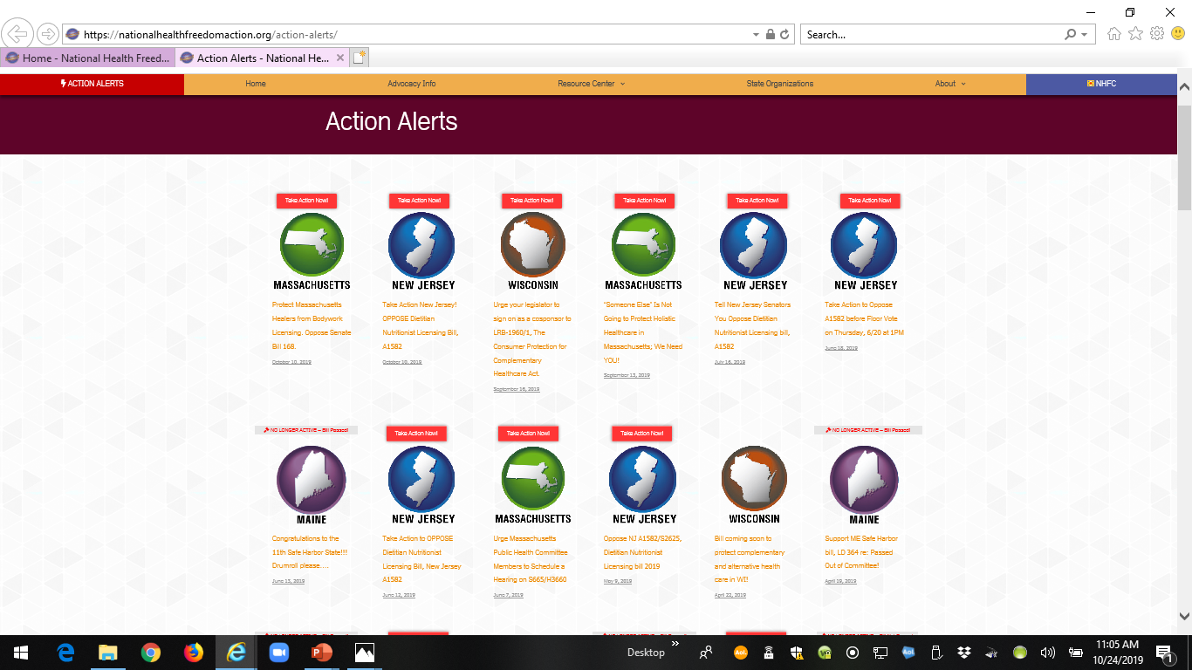

Slide 23
2021 Safe Harbor Health Freedom States!
Oklahoma *
Idaho *
Minnesota
Rhode Island
California
Louisiana
Arizona (limited)
New Mexico
Colorado
Nevada
Maine!

Slide 24
ME
WA
MT
ND
MN
MI
NH
NY
VT
WI
MA
SD
OR
ID
WY
OH
CT
RI
NE
IA
PA
IL
IN
NJ
DE
MO
WV
MD
CA
NV
DC
UT
CO
KS
AR
KY
VA
AZ
Homeopathy only
NM
OK
TN
NC
LA
MS
AL
GA
SC
TX
FL
AK
HI

Slide 25
Wisconsin Leaders at the Capitol

Slide 26
Massachusetts Leaders at the Capitol

Slide 27
Safe Harbor Maine Leaders at the Capitol

Slide 28
Federal Activism
Commerce

Slide 29
FDA Definition of Drug
The term “drug” means
(A) articles recognized in the official United States
Pharmacopoeia, official Homeopathic Pharmacopoeia of the United States, or official national Formulary, or any supplement to any of them; and
(B) articles intended for use in the diagnosis, cure, mitigation, treatment or prevention of disease in man or other animals; and
(C ) articles (other than food) intended to affect the structure or any function of the body of man or other animals; and
(D) articles intended for use as a component of any article specified in Clauses (A), (B) or (C ) of this paragraph. A food or dietary supplement for which a claim ….”.
21 U.S.C. 321(g)1

Slide 30
Homeopathic Remedies Unapproved Drugs
“Under the Federal Food, Drug, and Cosmetic Act, homeopathic products are subject to the same requirements related to approval, adulteration and misbranding as other drug products. There are currently no homeopathic products approved by FDA.” FDA Website September 23, 2020

Slide 31
Homeopathic Remedies
1988 Compliance Policy Guide Sec. 400.400
“Conditions Under Which Homeopathic Drugs May be Marketed”

Slide 32
Homeopathic Remedies
2017 FDA Draft Guidance
Plan to repeal 400.400 and do risk assessment
“Drug Products Labeled as Homeopathic: Guidance for FDA Staff and Industry”

Slide 33
Homeopathic Remedies
October 24, 2019
Compliance Policy Guide Sec. 400.400
Repealed/Withdrawn
Second Draft Guidance
Distributed for Comment

Slide 34
Homeopathic Remedies
November 2022
NO NEW FINAL REVISED GUIDANCE DOCUMENT

Slide 35
Homeopathic Remedies
Is FDA going to remove homeopathic products from the market?
“FDA’s top concern is patient safety. When the draft guidance is finalized, it will specify the categories of products the agency intends to prioritize for enforcement. In the interim, before the draft guidance is finalized, FDA intends to apply its general approach to prioritizing risk-based regulatory and enforcement action.”
FDA Website September 23, 2020

Slide 36
Homeopathic Remedies
A need for CHANGING THE LAW
Homeopathic Remedies should have the legal presumption of being Generally Recognized as Safe (GRAS).

Slide 37
Minnesota Statute 146A
(d) This chapter does not apply to, control, prevent, or restrict the practice, service, or activity of lawfully marketing or distributing food products, including dietary supplements as defined in the federal Dietary Supplement Health and Education Act, educating customers about such products, or explaining the uses of such products.
Under Minnesota law, an unlicensed complementary and alternative health care practitioner may not provide a medical diagnosis or recommend discontinuance of medically prescribed treatments.

Slide 38
Minnesota Statute 146A
Prohibited Acts (b) Complementary and alternative health care practices do not include surgery, x-ray radiation, administering or dispensing legend drugs and controlled substances, practices that invade the human body by puncture of the skin, setting fractures, the use of medical devices as defined in section 147A.01, any practice included in the practice of dentistry as defined in section 150A.05, subdivision 1, or the manipulation or adjustment of articulations of joints or the spine as described in section 146.23 or 148.01.

Slide 39
Minnesota Statute 146A
Prohibited Acts
(k) Improper or unauthorized personal or other use of any legend drugs as defined in chapter 151, any chemicals as defined in chapter 151, or any controlled substance as defined in chapter 152.

Slide 40
Essence of True Freedom
“Freedom is a Conversation”
Diane Miller JD

Slide 41
National Health Freedom Coalition a non-profit educational organization www.nationalhealthfreedom.org
National Health Freedom Action a non-profit lobbying organization
www.nationalhealthfreedomaction.org

