Slide 1
How Health Freedom Concepts and Current Policies Impact Herbalism
International Herbal Symposium
June 10-13 2021
Virtual Presentation
Diane M. Miller JD Director of Law and Public Policy
National Health Freedom Coalition

Slide 2
Freedom to Heal

Slide 3
Law - The Voice of
Freedom…

Slide 4
State Law
Practice: Healing
Federal Law
Products: Dietary Supplements and Drugs

Slide 5
State Law - Practice Are you helping someone with a health problem?
Federal Law - Selling Are you selling and staying within the what it says on the label?
Notes:
Broad definitions
Good for the profession because gives them great latitude in treating
Describes many tools that they have

Slide 6
State Law - Practicing
Are you helping someone with a health problem?
Notes:
Broad definitions
Good for the profession because gives them great latitude in treating
Describes many tools that they have

Slide 7
State of Minnesota Practice of Medicine Defined
(3) Offers or undertakes to prevent or diagnose, correct or treat by any means, methods, devices, or instrumentalities, any disease, illness, pain, wound, fracture, infirmity, deformity, or defect of any person
MN State 147.081 Gross Misdemeanor

Slide 8
EXEMPTION: MN 146A Complementary and Alternative Practices include but are not limited to:
(1) acupressure; (2) anthroposophy; (3) aroma therapy; (4) ayurveda; (5) cranial sacral therapy; (6) culturally traditional healing practices; (7) detoxification practices and therapies; (8) energetic healing; (9)polarity therapy; (10) folk practices; (11) healing practices utilizing food, food supplements, nutrients, and the physical forces of heat, cold, water, touch, and light; (12) Gerson therapy and colostrum therapy; (13) healing touch; (14) herbology or herbalism; (15) homeopathy; (16) nondiagnostic iridology; (17) body work, massage, and massage therapy; (18) meditation; (19) mind-body healing practices; (20) naturopathy; (21) noninvasive instrumentalities; and (22) traditional Oriental practices, such as Qi Gong energy healing.

Slide 9
State of Washington Practice of Medicine Defined
“…(1) Offers or undertakes to diagnose, cure, advise, or prescribe for any human disease, ailment, injury, infirmity, deformity, pain or other condition, physical or mental, real or imaginary, by any means or instrumentality;…” Washington RCW 18.71.011
Notes:
Broad definitions
Good for the profession because gives them great latitude in treating
Describes many tools that they have

Slide 10
State of Maine Practice of Medicine Defined
“…diagnosing, relieving in any degree or curing, or professing or attempting to diagnose, relieve or cure a human disease, ailment, defect or complaint, whether physical or mental, or of physical and mental origin, by attendance or by advice, or by prescribing or furnishing a drug, medicine, appliance, manipulation, method or a therapeutic agent whatsoever or in any other manner unless otherwise provided by statutes of this State ME Title 32, Chapter 48
Notes:
Broad definitions
Good for the profession because gives them great latitude in treating
Describes many tools that they have

Slide 11
State of Wisconsin Practice of Medicine Defined
“…(a) To examine into the fact, condition or cause of human health or disease, or to treat, operate, prescribe or advise for the same, by any means or instrumentality.
(b) To apply principles or techniques of medical sciences in the diagnosis or prevention of any of the conditions described in par. (a) and in sub. (2).
(c) To penetrate, pierce or sever the tissues of a human being.
(d) To offer, undertake, attempt or do or hold oneself out in any manner as able to do any of the acts described in this subsection.”
WI Stat. 448.01 (9)
Notes:
Broad definitions
Good for the profession because gives them great latitude in treating
Describes many tools that they have

Slide 12
Commonwealth of Massachusetts Practice of Medicine Defined
“…The purpose or reasonably foreseeable effect of which is to encourage the reliance of another person upon an individual's knowledge or skill in the maintenance of human health by the prevention, alleviation, or cure of disease, and involving or reasonably thought to involve an assumption of responsibility for the other person's physical or mental well being: diagnosis, treatment, use of instruments or other devices, or the prescribing, administering, dispensing or distributing of drugs for the relief of diseases or adverse physical or mental conditions.” CMR 243
Notes:
Broad definitions
Good for the profession because gives them great latitude in treating
Describes many tools that they have

Slide 13
State of Maryland Practice of Naturopathic Medicine
(g) (1) “Naturopathic medicine” means the prevention, diagnosis, and treatment of human health conditions, injury, and disease using only patient education and naturopathic therapies and therapeutic substances recognized by the Council of Naturopathic Medical Education.
(2) … (iii) The practice of the material sciences of healing, including nutrition, phytotherapy, treatment by natural substances, and external applications. §14–5F–01.

Slide 14
State of Maryland Naturopathic Medicine Felony
(a) Except as otherwise provided in this subtitle, an individual may not practice, attempt to practice, or offer to practice naturopathic medicine in this State without a license.
(b) An individual who violates this section is guilty of a felony and on conviction is subject to:
(1) A fine not exceeding $10,000 or imprisonment not exceeding 5 years or both; and
(2) A civil fine of no more than $50,000 to be levied by the Board. §14–5F–29.

Slide 15
Kansas Healing Arts Not a Natural Right
Purpose. Recognizing that the practice of the healing arts is a privilege granted by legislative authority and is not a natural right of individuals, it is deemed necessary as a matter of policy in the interests of public health, safety and welfare, to provide laws and provisions covering the granting of that privilege and its subsequent use, control and regulation to the end that the public shall be properly protected against unprofessional, improper, unauthorized and unqualified practice of the healing arts and from unprofessional conduct by persons licensed to practice under this act. 6KS 65-2801 Chapter 65.Article 28
Notes:
Broad definitions
Good for the profession because gives them great latitude in treating
Describes many tools that they have

Slide 16
Freedom Solutions
Safe Harbor
Practitioner Exemption Laws
Notes:
Broad definitions
Good for the profession because gives them great latitude in treating
Describes many tools that they have

Slide 17
Maine New Law Exemption
“The Right To Practice Complementary
and Alternative Health Care Act."
Sponsored by
Senator David Miramant
ME Title 32, Chapter 48
Notes:
Broad definitions
Good for the profession because gives them great latitude in treating
Describes many tools that they have

Slide 18
Maine New Law Prohibited Acts
A. Performing surgery, setting fractures or performing any other procedure on a person that punctures the skin;
B. Administering or prescribing radiation, including x-ray radiation;
C. Prescribing or administering medications, drugs or devices that require a prescription from a licensed health care professional;
D. Recommending the discontinuance of medications or drugs or the use of devices prescribed by a licensed health care professional;
E. Performing chiropractic adjustment of joints or spine; or
F. Acting in any way that suggests, advertises or implies that the person providing complementary or alternative health care services is licensed as a health care professional under any other chapter of this Title.
Notes:
Broad definitions
Good for the profession because gives them great latitude in treating
Describes many tools that they have

Slide 19
Nevada New Law Wellness Services
(a) Anthroposophy. (b) Aromatherapy. (c) Traditional cultural healing practices. (d) Detoxification practices and therapies. (e) Energetic healing. (f) Folk practices. (g) Gerson therapy and colostrum therapy. (h) Healing practices using food, dietary supplements, nutrients and the physical forces of heat, cold, water and light. (i) Herbology and herbalism. (j) Reflexology and Reiki. (k) Mind-body healing practices. (l) Nondiagnostic iridology. (m) Noninvasive instrumentalities. (n) Holistic kinesiology.

Slide 20
New Mexico New Law Complementary and Alternative Health Care Services:
B. "complementary and alternative health care service" means the broad domain of complementary and alternative healing methods and treatments including: (1) anthroposophy; (2) aromatherapy; (3) ayurveda; (4) culturally traditional healing practices, including practices by a curandera, sobadora, partera, medica and arbolaira, and healing traditions, including plant medicines and foods, prayer, ceremony and song; (5) detoxification practices and therapies; (6) energetic healing; (7) folk practices; (8) Gerson therapy and colostrum therapy; (9) healing practices utilizing food, dietary supplements, nutrients and the physical forces of heat, cold, water, touch and light; (10) healing touch; (11) herbology or herbalism; (12) homeopathy; (13) meditation; (14) mind-body healing practices; (15) naturopathy; (16) nondiagnostic iridology; (17) noninvasive instrumentalities; (18) polarity therapy; and (19) holistic kinesiology and other muscle testing techniques 61-35-2

Slide 21
Massachusetts Bills Safe Harbor Exemption
2021 S.1380/H.2343
(formerly SD1085/HD1169)
An Act providing for consumer access to and the right to practice complementary and alternative health care services
Senator Nick Collins
and
Representative John Lawn, Jr.
Referred to Committee on Public Health
Notes:
Broad definitions
Good for the profession because gives them great latitude in treating
Describes many tools that they have

Slide 22
Wisconsin Bills Safe Harbor Exemption
2021 SB98/AB86
Consumer Access and Right to Practice Complementary and Alternative Health Care
On way to Senate Floor
Notes:
Broad definitions
Good for the profession because gives them great latitude in treating
Describes many tools that they have

Slide 23
Special Topic
COVID
Can herbalists promise a cure?
State Law – unlicensed practice, fraud
Federal Law – labeling health claims

Slide 24
What is Happening Federally?
“The U.S. Food and Drug Administration is issuing warning letters to firms for selling fraudulent products with claims to prevent, treat, mitigate, diagnose or cure coronavirus disease 2019 (COVID-19). We are actively monitoring for any firms marketing products with fraudulent COVID-19 prevention and treatment claims.” (FDA website April 13, 2021)
FDA has sent warning letters to 168 companies for selling products.

Slide 25
What is happening in the states?
State Governor Emergency Power

Slide 26
State Laws – Police Power to protect health and welfare of citizens
1. Constitution
2. State Statutes
3. Administrative Regulations
4. Governor Executive Orders
Notes:
Broad definitions
Good for the profession because gives them great latitude in treating
Describes many tools that they have

Slide 27
State Statutes
State Lawmakers pass laws:
Including laws that delegate authority to Governors for emergency management.
Notes:
Broad definitions
Good for the profession because gives them great latitude in treating
Describes many tools that they have

Slide 28
Example State Statute
MN Stat. 12.21 GOVERNOR. §Subdivision 1.General authority.
The governor (1) has general direction and control of emergency management, (2) may carry out the provisions of this chapter, and (3) during a national security emergency declared as existing under section 12.31, during the existence of an energy supply emergency as declared under section 216C.15, or during the existence of an emergency resulting from an incident at a nuclear power plant that poses a radiological or other health hazard, may assume direct operational control over all or any part of the emergency management functions within this state.
Notes:
Broad definitions
Good for the profession because gives them great latitude in treating
Describes many tools that they have

Slide 29
Model State Emergency Health Powers Acts
In 2002 Many states passed what at the time was called the "Model State Emergency Health Powers Act." MEHPA.
ACLU stated that it was drafted as “model legislation to increase state powers to respond to bioterrorism or other outbreaks of disease that the Centers for Disease Control and others want the states to pass into law. Although such legislation is needed, the current draft of the Model Act unfortunately is written in a way that doesn't adequately protect citizens against the misuse of the tremendous powers that it would grant in an emergency.”
ACLU, Q and A on the Model State Health Emergency Powers Act, accessed online June 13, 2020 @ https://www.aclu.org/other/model-state-emergency-health-powers-act
Notes:
Broad definitions
Good for the profession because gives them great latitude in treating
Describes many tools that they have

Slide 30
Minnesota’s 2002 Right to Refuse
12.39 INDIVIDUAL TREATMENT; NOTICE, REFUSAL, CONSEQUENCE.
Subdivision 1. Refusal of treatment. Notwithstanding laws, rules, or orders made or promulgated in response to a national security emergency or peacetime emergency, individuals have a fundamental right to refuse medical treatment, testing, physical or mental examination, vaccination, participation in experimental procedures and protocols, collection of specimens, and preventive treatment programs. An individual who has been directed by the commissioner of health to submit to medical procedures and protocols because the individual is infected with or reasonably believed by the commissioner of health to be infected with or exposed to a toxic agent that can be transferred to another individual or a communicable disease, and the agent or communicable disease is the basis for which the national security emergency or peacetime emergency was declared, and who refuses to submit to them may be ordered by the commissioner to be placed in isolation or quarantine according to parameters set forth in sections 144.419 and 144.4195.

Slide 31
California Emergency Law
California Statute Health and Safety Code Section 120140. Upon being informed by a health officer of any contagious, infectious, or communicable disease the department may take measures as are necessary to ascertain the nature of the disease and prevent its spread. To that end, the department may, if it considers it proper, take possession or control of the body of any living person, or the corpse of any deceased person.
California Health and Safety Code Section 120140, accessed online June 13, 2020, @ http://leginfo.legislature.ca.gov/faces/codes_displaySection.xhtml?lawCode=HSC&sectionNum=120140.
Notes:
Broad definitions
Good for the profession because gives them great latitude in treating
Describes many tools that they have

Slide 32
Freedom to Practice
Freedom to Speak the Truth
A Time of Caution
A Time of Courage

Slide 33
How to Pass a Bill in Your State
www.nationalhealthfreedomaction.org
NHFA Attorneys to Help Guide
- Conference calls
- Travel and Presentations
- Drafting
- Testimony

Slide 35
2021 Safe Harbor Health Freedom States!
Oklahoma *
Idaho *
Minnesota
Rhode Island
California
Louisiana
Arizona (limited)
New Mexico
Colorado
Nevada
Maine!

Slide 36
ME
WA
MT
ND
MN
MI
NH
NY
VT
WI
MA
SD
OR
ID
WY
OH
CT
RI
NE
IA
PA
IL
IN
NJ
DE
MO
WV
MD
CA
NV
DC
UT
CO
KS
AR
KY
VA
AZ
Homeopathy only
NM
OK
TN
NC
LA
MS
AL
GA
SC
TX
FL
AK
HI

Slide 37
Wisconsin Leaders at the Capitol

Slide 38
Massachusetts Leaders at the Capitol

Slide 39
Safe Harbor Maine Leaders at the Capitol

Slide 40
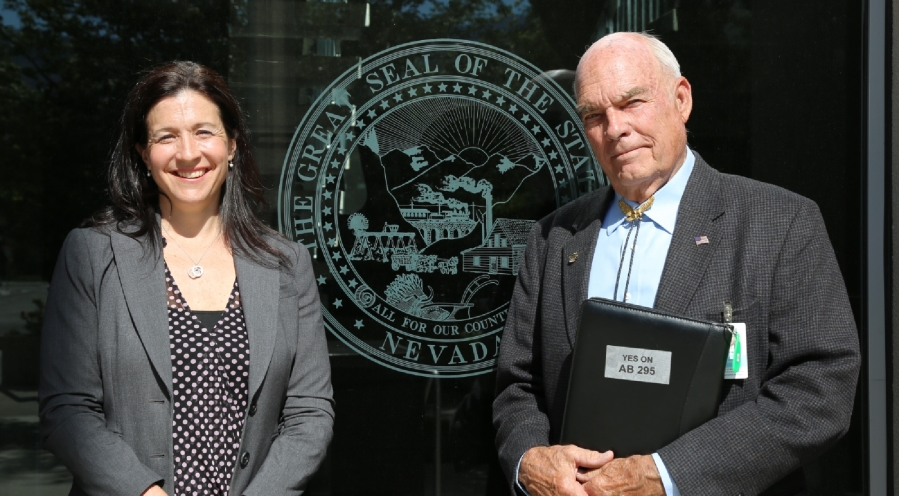
Nevada’s Collaboration with Lobbyist

Slide 41
State Health Freedom Groups Working on Many Issues
Practitioner Rights
Vaccine Exemption Rights
Bodily Autonomy Right to Refuse
Organic Food and Sovereignty
Geo-engineering
Microwave Radiation and EMFs
Glyphosates Roundup Levels
Regenerative Agricultural Projects

Slide 42
Federal Activism
Commerce

Slide 43
Federal Issues
Dietary Supplements – health claims
Homeopathic Remedies – Draft Guidance
Emergency COVID – Ex Orders
Geoengineering – who regulates the climate
Microwave Radiation and EMFs - satellites

Slide 44
FDA Definition of Drug
The term “drug” means
(A) articles recognized in the official United States
Pharmacopoeia, official Homeopathic Pharmacopoeia of the United States, or official national Formulary, or any supplement to any of them; and
(B) articles intended for use in the diagnosis, cure, mitigation, treatment or prevention of disease in man or other animals; and
(C ) articles (other than food) intended to affect the structure or any function of the body of man or other animals; and
(D) articles intended for use as a component of any article specified in Clauses (A), (B) or (C ) of this paragraph. A food or dietary supplement for which a claim ….”.
21 U.S.C. 321(g)1

Slide 45
1994 Drug Definition Revised
Drugs:…
(C ) articles (other than food) intended to affect the structure or any function of the body of man or other animals;

Slide 46
Food Includes Dietary Supplements
“A vitamin; A mineral; An herb or other botanical; An amino acid; A dietary substance for use by man to supplement the diet by increasing the total dietary intake; or A concentrate, metabolite, constituent, extract, or combination of any ingredient mentioned above…”

Slide 47
Dietary Supplements Include HERBS
“A vitamin; A mineral; An herb or other botanical; An amino acid; A dietary substance for use by man to supplement the diet by increasing the total dietary intake; or A concentrate, metabolite, constituent, extract, or combination of any ingredient mentioned above…”

Slide 48
U.S. Dietary Supplements
Regulated as FOODS and not drugs
Generally Regarded as Safe (GRAS)
unless proven otherwise

Slide 49
Homeopathic Remedies
How are homeopathic products regulated?
Drugs

Slide 50
FDA Definition of Drug
The term “drug” means
(A) articles recognized in the official United States
Pharmacopoeia, official Homeopathic Pharmacopoeia of the United States, or official national Formulary, or any supplement to any of them; and
(B) articles intended for use in the diagnosis, cure, mitigation, treatment or prevention of disease in man or other animals; and
(C ) articles (other than food) intended to affect the structure or any function of the body of man or other animals; and
(D) articles intended for use as a component of any article specified in Clauses (A), (B) or (C ) of this paragraph. A food or dietary supplement for which a claim ….”.
21 U.S.C. 321(g)1

Slide 51
Homeopathic Remedies Unapproved Drugs
“Under the Federal Food, Drug, and Cosmetic Act, homeopathic products are subject to the same requirements related to approval, adulteration and misbranding as other drug products. There are currently no homeopathic products approved by FDA.” FDA Website September 23, 2020

Slide 52
Homeopathic Remedies
1988 Compliance Policy Guide Sec. 400.400
“Conditions Under Which Homeopathic Drugs May be Marketed”

Slide 53
Homeopathic Remedies
2017 FDA Draft Guidance
Plan to repeal 400.400 and do risk assessment
“Drug Products Labeled as Homeopathic: Guidance for FDA Staff and Industry”

Slide 54
Homeopathic Remedies
October 24, 2019
Compliance Policy Guide Sec. 400.400
Repealed/Withdrawn
Second Draft Guidance
Distributed for Comment

Slide 55
Homeopathic Remedies
April 2021
NO NEW FINAL REVISED GUIDANCE DOCUMENT

Slide 56
Homeopathic Remedies
Is FDA going to remove homeopathic products from the market?
“FDA’s top concern is patient safety. When the draft guidance is finalized, it will specify the categories of products the agency intends to prioritize for enforcement. In the interim, before the draft guidance is finalized, FDA intends to apply its general approach to prioritizing risk-based regulatory and enforcement action.”
FDA Website September 23, 2020

Slide 57
WHO is representing YOU?
We need to be at the table long term if we plan to make a difference and protect health freedom.

Slide 58
www.nationalhealthfreedomaction.org
NATIONAL HEALTH FREEDOM ACTION
A 501 (c ) 4 Lobbying Organization
Diane Miller JD
Director of Law and Public Policy
PMB 218, 2136 Ford Parkway
St. Paul, MN 55116-1863
E-mail: similars@aol.com
651-470-7367

Slide 59
National Health Freedom Coalition a non-profit educational organization
PMB 218, 2136 Ford Parkway, St. Paul, MN , USA 55116-1863
www.nationalhealthfreedom.org
E-mail: similars@aol.com

Slide 60
U.S. Health Freedom Congress
Voting Members

Slide 61
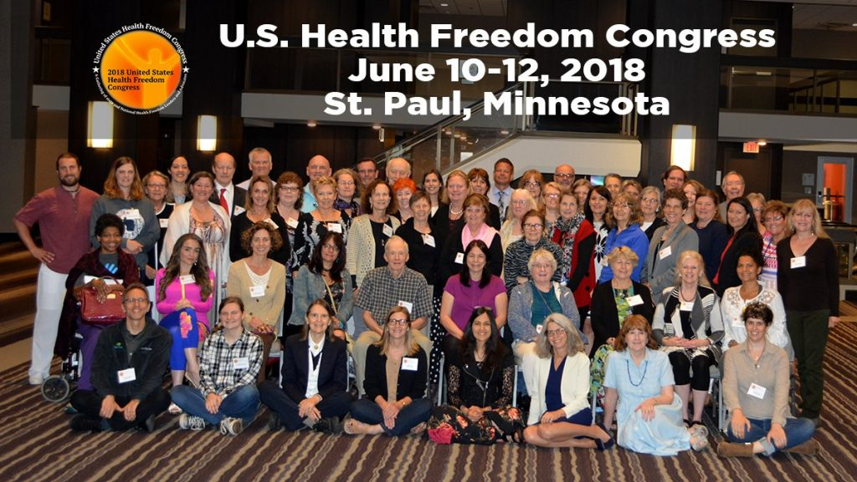

Slide 62
Principles of Health Freedom

Slide 63
Principle #1 The fundamental right of self-determination of individuals, to be let alone to survive on their own terms and in their own manner.

Slide 64
Principle #2 The freedom to perceive and to act as one wishes to secure health and survival.

Slide 65
Principle #3 The freedom to access who and what one needs or prefers for ones health and survival.

Slide 66
Principle #4 The responsibility to do no harm.

Slide 67
Principle #5 The responsibility to respectfully tolerate diverse options in health, healing, and survival choices.

Slide 68
Principle #6 The duty of corporations and institutions to be trustworthy entities upholding health freedom rights and liberties of members of the human family, and abiding by health freedom responsibilities.

Slide 69
Principle #7 And in light of the special legal nature of corporate entities and their systemic impact on the human family, the duty to:

Slide 70
#7-1 -honor and preserve the sovereign nature of individuals, the sovereignty of the United States; and avoid any negative impact on the sovereignty of other nation states;

Slide 71
#7-2 -honor and preserve American financial and cultural diversity and multicultural systems, and avoid negative financial or cultural impacts on other nation states;

Slide 72
#7-3 -avoid creating or being monopolies, and avoid the use of large monopolistic ownership of resources to dominate cultures, public policies, regulations and laws;

Slide 73
#7-4 -avoid dominant control of natural resources, avoid the suppression of access to natural resources, and avoid potentially harmful modification or destruction of natural resources; and

Slide 74
#7-5 -avoid promotion of products, protocols, policies, regulations, or laws, that would encourage unlimited dependence on corporations and institutions, or that would discourage, prohibit, or otherwise negatively impact the ability or will of humans and local human communities to survive and prosper without the corporation of institution.

Slide 75
Principle #8
The duty of the government to protect health freedom and to make no law or public policy abridging health freedom or its fundamental principles.

Slide 76
BE AN AGENT OF CHANGE
Laws and customs must be carefully reviewed, revised, and even repealed if necessary, and new laws created, to reflect the development, evolution, and spiritual maturization of a people. -Diane Miller

Slide 77
Essence of True Freedom
“Freedom is a Conversation”
Diane Miller JD

Slide 78
National Health Freedom Coalition a non-profit educational organization www.nationalhealthfreedom.org
National Health Freedom Action a non-profit lobbying organization
www.nationalhealthfreedomaction.org

