Slide 1
Shaping Laws to Protect Health and Healing Rights
Life Unlimited November 9, 2021
Diane M. Miller JD Director of Law and Public Policy
National Health Freedom Coalition

Slide 2
Law - The Voice of
Freedom…

Slide 3
The Right to Heal
Yourself and Others
State Law
Practicing the Healing Arts Federal Law
Access to Products including Food and Dietary Supplements

Slide 4
State of Minnesota Practice of Medicine Defined
(3) Offers or undertakes to prevent or diagnose, correct or treat by any means, methods, devices, or instrumentalities, any disease, illness, pain, wound, fracture, infirmity, deformity, or defect of any person
MN State 147.081 Gross Misdemeanor

Slide 5
EXEMPTION: MN 146A Complementary and Alternative Practices include but are not limited to:
(1) acupressure; (2) anthroposophy; (3) aroma therapy; (4) ayurveda; (5) cranial sacral therapy; (6) culturally traditional healing practices; (7) detoxification practices and therapies; (8) energetic healing; (9)polarity therapy; (10) folk practices; (11) healing practices utilizing food, food supplements, nutrients, and the physical forces of heat, cold, water, touch, and light; (12) Gerson therapy and colostrum therapy; (13) healing touch; (14) herbology or herbalism; (15) homeopathy; (16) nondiagnostic iridology; (17) body work, massage, and massage therapy; (18) meditation; (19) mind-body healing practices; (20) naturopathy; (21) noninvasive instrumentalities; and (22) traditional Oriental practices, such as Qi Gong energy healing.

Slide 6
Kansas Healing Arts Not a Natural Right
Purpose. Recognizing that the practice of the healing arts is a privilege granted by legislative authority and is not a natural right of individuals, it is deemed necessary as a matter of policy in the interests of public health, safety and welfare, to provide laws and provisions covering the granting of that privilege and its subsequent use, control and regulation to the end that the public shall be properly protected against unprofessional, improper, unauthorized and unqualified practice of the healing arts and from unprofessional conduct by persons licensed to practice under this act. 6KS 65-2801 Chapter 65.Article 28
Notes:
Broad definitions
Good for the profession because gives them great latitude in treating
Describes many tools that they have

Slide 7
2021 Safe Harbor Health Freedom States!
Oklahoma *
Idaho *
Minnesota
Rhode Island
California
Louisiana
Arizona (limited)
New Mexico
Colorado
Nevada
Maine!

Slide 8
ME
WA
MT
ND
MN
MI
NH
NY
VT
WI
MA
SD
OR
ID
WY
OH
CT
RI
NE
IA
PA
IL
IN
NJ
DE
MO
WV
MD
CA
NV
DC
UT
CO
KS
AR
KY
VA
AZ
Homeopathy only
NM
OK
TN
NC
LA
MS
AL
GA
SC
TX
FL
AK
HI

Slide 9
The Fundamental Constitutional Right to Make Ones Own Health Decisions Is a Matter of Survival

Slide 10
Will concentrations of power and money and the owners of technology dominate and replace our government? Will the government of the people, by the people, and for the people perish from this earth?

Slide 11
2020 and 2021
State Governor Emergency Orders
Stay at Home
Lose Your Job
Social Distance
Wear a Mask
Get vaccinated

Slide 12
State Laws – Police Power
1. State Constitution
2. State Statutes
3. State Administrative Regs
4. Governor Executive Orders
Notes:
Broad definitions
Good for the profession because gives them great latitude in treating
Describes many tools that they have

Slide 13
Minnesota’s 2002 Right to Refuse
12.39 INDIVIDUAL TREATMENT; NOTICE, REFUSAL, CONSEQUENCE.
Subdivision 1. Refusal of treatment. Notwithstanding laws, rules, or orders made or promulgated in response to a national security emergency or peacetime emergency, individuals have a fundamental right to refuse medical treatment, testing, physical or mental examination, vaccination, participation in experimental procedures and protocols, collection of specimens, and preventive treatment programs. An individual who has been directed by the commissioner of health to submit to medical procedures and protocols because the individual is infected with or reasonably believed by the commissioner of health to be infected with or exposed to a toxic agent that can be transferred to another individual or a communicable disease, and the agent or communicable disease is the basis for which the national security emergency or peacetime emergency was declared, and who refuses to submit to them may be ordered by the commissioner to be placed in isolation or quarantine according to parameters set forth in sections 144.419 and 144.4195.

Slide 14
Governor Powers Challenged in Wisconsin
May 13, 2020: The Supreme Court of Wisconsin overturned its Governor’s stay-at-home order with judicial comments reflecting that expansive Governor orders cannot go beyond the constitutional inalienable rights of citizens, even in the case of declared emergencies. “It is especially in times of emergency that we must protect the rights of the people, lest we establish a dangerous precedent empowering less benevolent government officials in the future to oppress the people in the name of exigency.” .
Wisconsin Legislature v. Secretary of Wisconsin Department of Health Services, 2020 Wis. 42 (May 13, 2020) (4-3 decision) (quoting Grassl Bradley, J., concurring), accessed online June 13, 2020 @ https://nationalhealthfreedomaction.org/wp-content/uploads/2020/05/Corona-Virus-Supreme-Court-Wisconsin.pdf

Slide 15
Governor Powers Challenged Pennsylvania
September 14, 2020, the federal Court for the Western District of Pennsylvania, declared the Pennsylvania Executive Orders on (1) restrictions on gatherings and (2) closing “non-life sustaining” businesses and directing Pennsylvanians to stay-at-home unconstitutional. The federal court cited Jacobson v. Massachusetts, 197 U.S. 11, 31 (1905) to discuss when and when not to give broad deference to state government during emergencies and to show how Courts have evolved over time in the past 100 years since the Jacobson case to be more vigilant in the protection of civil liberties and the need to apply regular constitutional scrutiny when civil liberties are at stake.

Slide 16
Governor Powers Challenged in Michigan
On October 2, 2020, The Supreme Court of the State of Michigan issued an opinion declaring the Michigan EPGA (Emergency Powers of the Governor Act) unconstitutional. The Court’s conclusion was based on the fact that the law “purports to delegate to the executive branch, the legislative powers of state government—including its plenary police powers—and to allow the exercise of such powers indefinitely.” [i]
The high Court said the scope of the law and the expansiveness of the authority it concentrates in a single public official was “extraordinary”.

Slide 17
2021 Extensions of State Governor Emergency Orders New Governor mandates State Dept of Health regular powers reviewed Local cities and counties mandates Lawsuits against state, counties, cities Corporations making their own mandates according to CDC OSHA Lawsuits against corporations and institutions States passing laws to curb power of governments and corp. Legislatures terminating Governor powers Economic crisis Polarization geographically Adverse events and deaths from mandates Blaming noncompliant Americans Censorship by Big Tech Rallies protests shutdowns

Slide 18
-

Slide 19
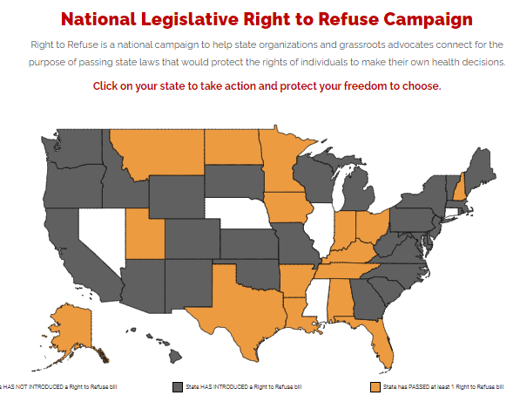

Slide 20
2021 COVID Mandates CHALLENGED

Slide 21
2021 Massachusetts Right to Refuse Legislation House Docket 4452
Every person has the natural, essential, and inherent right to bodily integrity, free from any threat or compulsion by government to accept an immunization. Accordingly, no person may be compelled to receive an immunization for COVID-19 in order to secure, receive, or access any public facility, any public benefit, or any public service from the Commonwealth of Massachusetts, or any political subdivision thereof,…
Public employees cannot be fired for declining COVID-19 vaccine. No COVID-19 passports.

Slide 22
2021 University Mandate Challenged in Virginia
August 3, 2021: A lawsuit was filed in the United States District Court for the Eastern District of Virginia - Zywicki v. George Mason University
George Mason University reversed its decision denying law professor Todd Zywicki a medical exemption from the university’s COVID vaccine mandate, after Zywicki and the New Civil Liberties Alliance sued the institution for violating Zywicki’s rights under Ninth and Fourteenth Amendments to the U.S. Constitution. Zywicki had robust natural immunity.

Slide 23
2021 Michigan Athletes Protected Against Vaccine Mandates
On August 31, the federal court in Michigan issued a temporary restraining order (TRO) in favor of four college athletes in a case against Western Michigan University (WMU).
On September 9, Judge Maloney, followed up on the TRO by a hearing with all parties and the judge then granted a preliminary injunction to the athletes allowing the athletes to continue to compete.

Slide 24
2021 New York Health Care Workers Protected Against Vaccine Mandates
On September 14, Judge David N. Hurd of the US District Court in Utica, New York issued a TRO on behalf of the medical professionals who hold, “sincere religious beliefs [which] compel them to refuse the COVID-19 vaccines that are currently available.”
The court ordered that 1) the vaccine mandate is suspended to the extent the DOH is barred from forcing employers to deny or revoke religious exemptions, 2) DOH is barred from interfering with religious exemptions going forward or with prior exemptions, and 3) DOH is barred from taking any action against plaintiffs for seeking or having a religious exemption

Slide 25
2020 COVID FEDERAL POWER
Travel Restrictions
Interstate Commerce
Access to Products
Individual Unemployment Relief
Individual Financial Relief
Funds to State Public Health Emergencies

Slide 26
2021 COVID FEDERAL POWER
Federal Employee Vaccine Mandates
Private Employees 100 or more OSHA

Slide 27
2021 COVID Courts
Thousands of cases going forward
Righttorefuse.org Legal Referral Menu

Slide 28
www.nationalhealthfreedomaction.org
NATIONAL HEALTH FREEDOM ACTION
A 501 (c ) 4 Lobbying Organization
Diane Miller JD
Director of Law and Public Policy
PMB 218, 2136 Ford Parkway
St. Paul, MN 55116-1863
E-mail: similars@aol.com
651-470-7367

Slide 29
National Health Freedom Coalition a non-profit educational organization
PMB 218, 2136 Ford Parkway, St. Paul, MN , USA 55116-1863
www.nationalhealthfreedom.org
E-mail: similars@aol.com

Slide 30
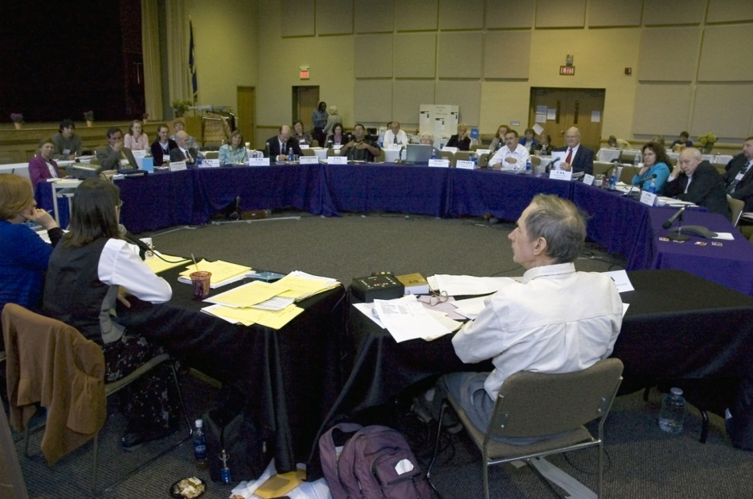
U.S. Health Freedom Congress
Voting Members

Slide 31
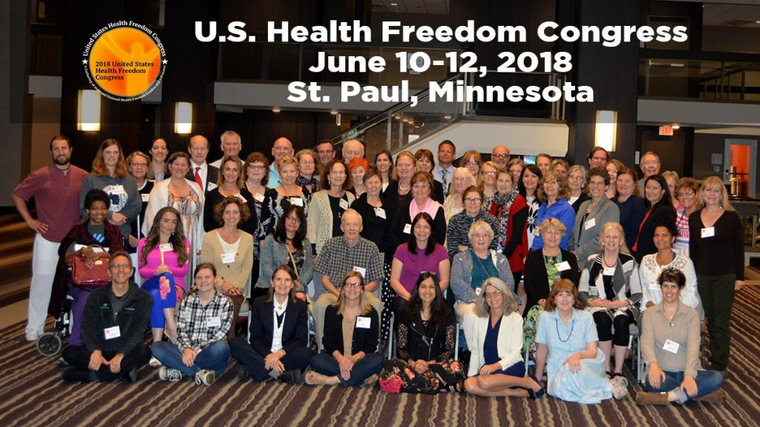

Slide 32
Principles of Health Freedom

Slide 33
Principle #1. The fundamental right of self-determination of individuals, to be let alone to survive on their own terms and in their own manner.

Slide 34
Principle #2. The freedom to perceive and to act as one wishes to secure health and survival.

Slide 35
Principle #3 The freedom to access who and what one needs or prefers for ones health and survival.

Slide 36
Principle #4 The responsibility to do no harm.

Slide 37
Principle #5 The responsibility to respectfully tolerate diverse options in health, healing, and survival choices.

Slide 38
Principle #6 The duty of corporations and institutions to be trustworthy entities upholding health freedom rights and liberties of members of the human family, and abiding by health freedom responsibilities.

Slide 39
Principle #7 And in light of the special legal nature of corporate entities and their systemic impact on the human family, the duty to:

Slide 40
#7-1 -honor and preserve the sovereign nature of individuals, the sovereignty of the United States; and avoid any negative impact on the sovereignty of other nation states;

Slide 41
#7-2 -honor and preserve American financial and cultural diversity and multicultural systems, and avoid negative financial or cultural impacts on other nation states;

Slide 42
#7-3 -avoid creating or being monopolies, and avoid the use of large monopolistic ownership of resources to dominate cultures, public policies, regulations and laws;

Slide 43
#7-4 -avoid dominant control of natural resources, avoid the suppression of access to natural resources, and avoid potentially harmful modification or destruction of natural resources; and

Slide 44
#7-5 -avoid promotion of products, protocols, policies, regulations, or laws, that would encourage unlimited dependence on corporations and institutions, or that would discourage, prohibit, or otherwise negatively impact the ability or will of humans and local human communities to survive and prosper without the corporation of institution.

Slide 45
Principle #8
The duty of the government to protect health freedom and to make no law or public policy abridging health freedom or its fundamental principles.

Slide 46
BE AN AGENT OF CHANGE
Laws and customs must be carefully reviewed, revised, and even repealed if necessary, and new laws created, to reflect the development, evolution, and spiritual maturization of a people. -Diane Miller

Slide 47
Essence of True Freedom
“Freedom is a Conversation”
Diane Miller JD

Slide 48
National Health Freedom Coalition a non-profit educational organization www.nationalhealthfreedom.org
National Health Freedom Action a non-profit lobbying organization
www.nationalhealthfreedomaction.org

