Slide 1
Practitioner Safe Harbor Exemption Laws for Complementary and Alternative Health Practitioners
Diane Miller JD
Director of Law and Public Policy
National Health Freedom Coalition

Slide 2
Freedom to Heal

Slide 3
Law - The Voice of
Freedom…

Slide 4
State Law
Practice
Federal Law
Dietary Supplements and Drugs

Slide 5
Practicing – State Law
Are you helping someone with a health problem?
Notes:
Broad definitions
Good for the profession because gives them great latitude in treating
Describes many tools that they have

Slide 6
Practice – State Law Are you helping someone with a health problem?
Selling – Federal Law Are you selling and staying within the what it says on the label?
Notes:
Broad definitions
Good for the profession because gives them great latitude in treating
Describes many tools that they have

Slide 7
Practice of Medicine Defined
Subd. 3.Practice of medicine defined. For purposes of this chapter, a person not exempted under section 147.09 is "practicing medicine" or engaged in the "practice of medicine" if the person does any of the following:
(1) advertises, holds out to the public, or represents in any manner that the person is authorized to practice medicine in this state;
(2) offers or undertakes to prescribe, give, or administer any drug or medicine for the use of another;
(3) offers or undertakes to prevent or to diagnose, correct, or treat in any manner or by any means, methods, devices, or instrumentalities, any disease, illness, pain, wound, fracture, infirmity, deformity or defect of any person;
(4) offers or undertakes to perform any surgical operation including any invasive or noninvasive procedures involving the use of a laser or laser assisted device, upon any person; or
(5) offers to undertake to use hypnosis for the treatment or relief of any wound, fracture, or bodily injury, infirmity, or disease. MN 147.081 Gross Misdemeanor

Slide 8
EXEMPTION: MN 146A Complementary and Alternative Practices include but are not limited to:
(1) acupressure; (2) anthroposophy; (3) aroma therapy; (4) ayurveda; (5) cranial sacral therapy; (6) culturally traditional healing practices; (7) detoxification practices and therapies; (8) energetic healing; (9)polarity therapy; (10) folk practices; (11) healing practices utilizing food, food supplements, nutrients, and the physical forces of heat, cold, water, touch, and light; (12) Gerson therapy and colostrum therapy; (13) healing touch; (14) herbology or herbalism; (15) homeopathy; (16) nondiagnostic iridology; (17) body work, massage, and massage therapy; (18) meditation; (19) mind-body healing practices; (20) naturopathy; (21) noninvasive instrumentalities; and (22) traditional Oriental practices, such as Qi Gong energy healing.

Slide 9
Washington State Law PRACTICE OF MEDICINE Defined
“…(1) Offers or undertakes to diagnose, cure, advise, or prescribe for any human disease, ailment, injury, infirmity, deformity, pain or other condition, physical or mental, real or imaginary, by any means or instrumentality;…” Washington RCW 18.71.011
Notes:
Broad definitions
Good for the profession because gives them great latitude in treating
Describes many tools that they have

Slide 10
Maine State Law PRACTICE OF MEDICINE
“…diagnosing, relieving in any degree or curing, or professing or attempting to diagnose, relieve or cure a human disease, ailment, defect or complaint, whether physical or mental, or of physical and mental origin, by attendance or by advice, or by prescribing or furnishing a drug, medicine, appliance, manipulation, method or a therapeutic agent whatsoever or in any other manner unless otherwise provided by statutes of this State. ME Title 32, Chapter 48
Notes:
Broad definitions
Good for the profession because gives them great latitude in treating
Describes many tools that they have

Slide 11
Wisconsin State Law PRACTICE OF MEDICINE
“…(a) To examine into the fact, condition or cause of human health or disease, or to treat, operate, prescribe or advise for the same, by any means or instrumentality.
(b) To apply principles or techniques of medical sciences in the diagnosis or prevention of any of the conditions described in par. (a) and in sub. (2).
(c) To penetrate, pierce or sever the tissues of a human being.
(d) To offer, undertake, attempt or do or hold oneself out in any manner as able to do any of the acts described in this subsection.”
WI Stat. 448.01 (9)
Notes:
Broad definitions
Good for the profession because gives them great latitude in treating
Describes many tools that they have

Slide 12
Massachusetts State Law PRACTICE OF MEDICINE
“…The purpose or reasonably foreseeable effect of which is to encourage the reliance of another person upon an individual's knowledge or skill in the maintenance of human health by the prevention, alleviation, or cure of disease, and involving or reasonably thought to involve an assumption of responsibility for the other person's physical or mental well being: diagnosis, treatment, use of instruments or other devices, or the prescribing, administering, dispensing or distributing of drugs for the relief of diseases or adverse physical or mental conditions.”
CMR 243
Notes:
Broad definitions
Good for the profession because gives them great latitude in treating
Describes many tools that they have

Slide 13
Maryland State Law Practice of Naturopathic Medicine
(g) (1) “Naturopathic medicine” means the prevention, diagnosis, and treatment of human health conditions, injury, and disease using only patient education and naturopathic therapies and therapeutic substances recognized by the Council of Naturopathic Medical Education.
(2) … (iii) The practice of the material sciences of healing, including nutrition, phytotherapy, treatment by natural substances, and external applications. §14–5F–01.

Slide 14
Maryland State Law Felony
(a) Except as otherwise provided in this subtitle, an individual may not practice, attempt to practice, or offer to practice naturopathic medicine in this State without a license.
(b) An individual who violates this section is guilty of a felony and on conviction is subject to:
(1) A fine not exceeding $10,000 or imprisonment not exceeding 5 years or both; and
(2) A civil fine of no more than $50,000 to be levied by the Board. §14–5F–29.

Slide 15
Kansas Healing Arts Not a Natural Right
Purpose. Recognizing that the practice of the healing arts is a privilege granted by legislative authority and is not a natural right of individuals, it is deemed necessary as a matter of policy in the interests of public health, safety and welfare, to provide laws and provisions covering the granting of that privilege and its subsequent use, control and regulation to the end that the public shall be properly protected against unprofessional, improper, unauthorized and unqualified practice of the healing arts and from unprofessional conduct by persons licensed to practice under this act. 6KS 65-2801 Chapter 65.Article 28
Notes:
Broad definitions
Good for the profession because gives them great latitude in treating
Describes many tools that they have

Slide 16
Freedom Solutions
Safe Harbor Practitioner
Exemption Laws
Notes:
Broad definitions
Good for the profession because gives them great latitude in treating
Describes many tools that they have

Slide 17
Maine New Law Exemption
“The Right To Practice Complementary
and Alternative Health Care Act."
Sponsored by
Senator David Miramant
ME Title 32, Chapter 48
Notes:
Broad definitions
Good for the profession because gives them great latitude in treating
Describes many tools that they have

Slide 18
Nevada Wellness Services
(a) Anthroposophy. (b) Aromatherapy. (c) Traditional cultural healing practices. (d) Detoxification practices and therapies. (e) Energetic healing. (f) Folk practices. (g) Gerson therapy and colostrum therapy. (h) Healing practices using food, dietary supplements, nutrients and the physical forces of heat, cold, water and light. (i) Herbology and herbalism. (j) Reflexology and Reiki. (k) Mind-body healing practices. (l) Nondiagnostic iridology. (m) Noninvasive instrumentalities. (n) Holistic kinesiology.

Slide 19
New Mexico 61-35-2 Complementary and Alternative Health Care Services:
B. "complementary and alternative health care service" means the broad domain of complementary and alternative healing methods and treatments including: (1) anthroposophy; (2) aromatherapy; (3) ayurveda; (4) culturally traditional healing practices, including practices by a curandera, sobadora, partera, medica and arbolaira, and healing traditions, including plant medicines and foods, prayer, ceremony and song; (5) detoxification practices and therapies; (6) energetic healing; (7) folk practices; (8) Gerson therapy and colostrum therapy; (9) healing practices utilizing food, dietary supplements, nutrients and the physical forces of heat, cold, water, touch and light; (10) healing touch; (11) herbology or herbalism; (12) homeopathy; (13) meditation; (14) mind-body healing practices; (15) naturopathy; (16) nondiagnostic iridology; (17) noninvasive instrumentalities; (18) polarity therapy; and (19) holistic kinesiology and other muscle testing techniques

Slide 20
Massachusetts Bill to Get Broader Exemptions
H.3660
Representative John Lawn, Jr.
An Act providing for consumer access to and the right to practice complementary and alternative health care services
S.665
Senator Nick Collins
An Act providing for consumer access to and the right to practice complementary and alternative health care services
Notes:
Broad definitions
Good for the profession because gives them great latitude in treating
Describes many tools that they have

Slide 21
Wisconsin Bills Practitioner Exemptions
2019 Senate Bill 492
Introduced by Senators Tiffany, Kooyenga and Olsen;
2019 Assembly Bill 546 Introduced by Representatives Felzkowski, Dittrich, Horlacher, Kitchens, Murphy, Mursau, Quinn, Ramthun, Schraa, Skowronski, Tusler and Zimmerman;
Relating to: providing complementary and alternative health care practitioners with exemptions from practice protection laws, requirements and prohibitions f...
Notes:
Broad definitions
Good for the profession because gives them great latitude in treating
Describes many tools that they have

Slide 22
How to Pass a Bill in Your State
www.nationalhealthfreedomaction.org
NHFA Attorneys to Help Guide
- Conference calls
- Travel and Presentations
- Drafting
- Testimony

Slide 24
2019 Safe Harbor Health Freedom States!
Oklahoma *
Idaho *
Minnesota
Rhode Island
California
Louisiana
Arizona (limited)
New Mexico
Colorado
Nevada
Maine!

Slide 25
ME
WA
MT
ND
MN
MI
NH
NY
VT
WI
MA
SD
OR
ID
WY
OH
CT
RI
NE
IA
PA
IL
IN
NJ
DE
MO
WV
MD
CA
NV
DC
UT
CO
KS
AR
KY
VA
AZ
Homeopathy only
NM
OK
TN
NC
LA
MS
AL
GA
SC
TX
FL
AK
HI

Slide 26
Safe Harbor Maine at the Capitol

Slide 27
Massachusetts Leaders at the Capitol

Slide 28
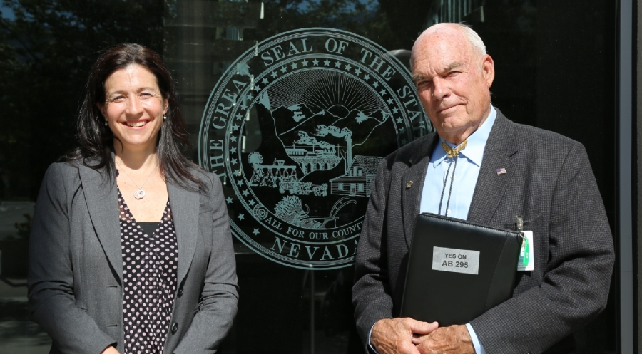
Nevada’s Collaboration with Lobbyist

Slide 29
State Health Freedom Groups Working on Many Issues
Practitioner Rights
Vaccine Exemption Rights
GMO Labeling
Geo-engineering
Electromagnetic Frequency
Glyphosates Roundup Levels
Regenerative Projects

Slide 30
Federal Activism
Federal commerce

Slide 31
Federal Issues
Homeopathic Remedies – Draft Guidance
GMO Labeling – Passage of Dark Act
Vaccine Mandates – state by state
Dietary Supplements – health claims
Geoengineering – who regulates the climate
Electromagnetic Frequencies - pervasive

Slide 32
FDA Definition of Drug
The term “drug” means
articles recognized in the official United States Pharmacopoeia, official Homeopathic Pharmacopoeia of the United States, or official national Formulary, or any supplement to any of them; and
(B) articles intended for use in the diagnosis, cure, mitigation, treatment or prevention of disease in man or other animals; and
(C ) articles (other than food) intended to affect the structure or any function of the body of man or other animals; and
(D) articles intended for use as a component of any article specified in Clauses (A), (B) or (C ) of this paragraph. A food or dietary supplement for which a claim ….”.
21 U.S.C. 321(g)1

Slide 33
U.S. Dietary Supplements
(C ) articles (other than food) intended to affect the structure or any function of the body of man or other animals;

Slide 34
Herbs are Regulated as Food
“A vitamin; A mineral; An herb or other botanical; An amino acid; A dietary substance for use by man to supplement the diet by increasing the total dietary intake; or A concentrate, metabolite, constituent, extract, or combination of any ingredient mentioned above…”

Slide 35
U.S. Dietary Supplements
* Regulated as Foods and not drugs
* Generally Regarded as Safe (GRAS)
unless proven otherwise

Slide 36
Homeopathic Remedies
FDA Draft Guidance
“Drug Products Labeled as Homeopathic: Guidance for FDA Staff and Industry”

Slide 37
Homeopathic Remedies
Attempted Repeal of Compliance Policy Guide Sec. 400.400
“Conditions Under Which Homeopathic Drugs May be Marketed”

Slide 38
WHO is representing YOU?
We need to be at the table long term if we plan to make a difference and protect health freedom.

Slide 39
www.nationalhealthfreedomaction.org
NATIONAL HEALTH FREEDOM ACTION
A 501 (c ) 4 Lobbying Organization
Diane Miller JD
Director of Law and Public Policy
PMB 218, 2136 Ford Parkway
St. Paul, MN 55116-1863
E-mail: similars@aol.com
651-470-7367

Slide 40
National Health Freedom Coalition a non-profit educational organization
PMB 218, 2136 Ford Parkway, St. Paul, MN , USA 55116-1863
www.nationalhealthfreedom.org
E-mail: similars@aol.com

Slide 41
U.S. Health Freedom Congress
Voting Members

Slide 42
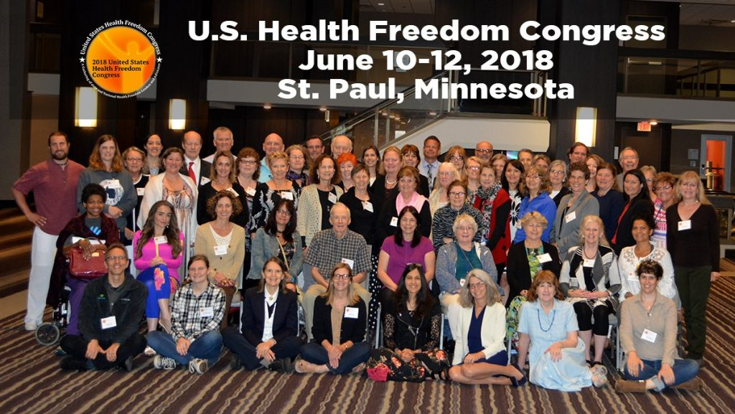

Slide 43
Principles of Health Freedom

Slide 44
Principle #1. The fundamental right of self-determination of individuals, to be let alone to survive on their own terms and in their own manner.

Slide 45
Principle #2. The freedom to perceive and to act as one wishes to secure health and survival.
Speak freely
Move about and associate freely
Perceive, believe, meditate, and pray freely
- Practice the healing arts

Slide 46
Principle #3 The freedom to access who and what one needs or prefers for ones health and survival.

Slide 47
Principle #4 The responsibility to do no harm.

Slide 48
Principle #5 The responsibility to respectfully tolerate diverse options in health, healing, and survival choices.

Slide 49
Principle #6 The duty of corporations and institutions to be trustworthy entities upholding health freedom rights and liberties of members of the human family, and abiding by health freedom responsibilities.

Slide 50
Principle #7 And in light of the special legal nature of corporate entities and their systemic impact on the human family, the duty to:

Slide 51
#7-1 -honor and preserve the sovereign nature of individuals, the sovereignty of the United States; and avoid any negative impact on the sovereignty of other nation states;

Slide 52
#7-2 -honor and preserve American financial and cultural diversity and multicultural systems, and avoid negative financial or cultural impacts on other nation states;

Slide 53
#7-3 -avoid creating or being monopolies, and avoid the use of large monopolistic ownership of resources to dominate cultures, public policies, regulations and laws;

Slide 54
#7-4 -avoid dominant control of natural resources, avoid the suppression of access to natural resources, and avoid potentially harmful modification or destruction of natural resources; and

Slide 55
#7-5 -avoid promotion of products, protocols, policies, regulations, or laws, that would encourage unlimited dependence on corporations and institutions, or that would discourage, prohibit, or otherwise negatively impact the ability or will of humans and local human communities to survive and prosper without the corporation of institution.

Slide 56
Principle #8
The duty of the government to protect health freedom and to make no law or public policy abridging health freedom or its fundamental principles.

Slide 57
BE AN AGENT OF CHANGE
Laws and customs must be carefully reviewed, revised, and even repealed if necessary, and new laws created, to reflect the development, evolution, and spiritual maturization of a people. -Diane Miller

Slide 58
Freedom Solutions
“A healthy person or community will throw off too much restriction of sovereignty in order to control their own destiny.” Diane Miller
Solution:
Control in the “least restrictive means” to the point where there is no substance left except the essence of order and harmony: “responsible freedom”.

Slide 59
Essence of True Freedom
“Freedom is a Conversation”
Diane Miller JD

