Slide 1
2019 Homeopathic Practice and State Laws
Diane Miller JD
Director of Law and Public Policy
National Health Freedom Coalition

Slide 2
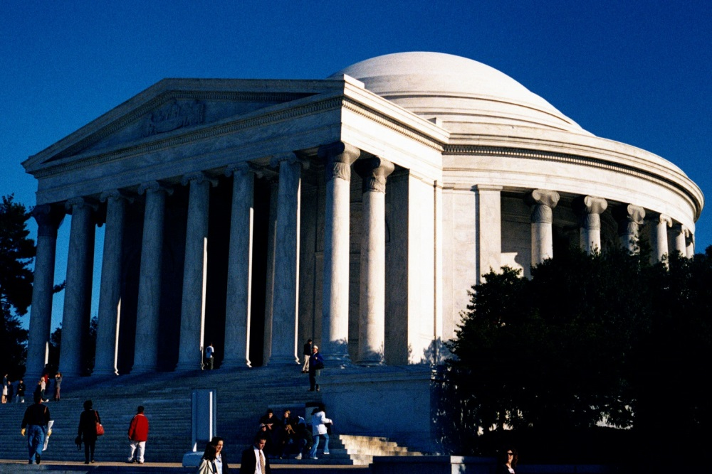
State Law
Homeopathic
Practice
Federal Law
Homeopathic Remedies

Slide 3
Homeopathic Practice
State Criminal Laws for Practice
Definition of Medicine: Minnesota
Subd. 3.Practice of medicine defined. For purposes of this chapter, a person not exempted under section 147.09 is "practicing medicine" or engaged in the "practice of medicine" if the person does any of the following:
(1) advertises, holds out to the public, or represents in any manner that the person is authorized to practice medicine in this state;
(2) offers or undertakes to prescribe, give, or administer any drug or medicine for the use of another;
(3) offers or undertakes to prevent or to diagnose, correct, or treat in any manner or by any means, methods, devices, or instrumentalities, any disease, illness, pain, wound, fracture, infirmity, deformity or defect of any person;
(4) offers or undertakes to perform any surgical operation including any invasive or noninvasive procedures involving the use of a laser or laser assisted device, upon any person; or
(5) offers to undertake to use hypnosis for the treatment or relief of any wound, fracture, or bodily injury, infirmity, or disease.

Slide 4
MN 146A Complementary and Alternative Practices include but are not limited to:
(1) acupressure; (2) anthroposophy; (3) aroma therapy; (4) ayurveda; (5) cranial sacral therapy; (6) culturally traditional healing practices; (7) detoxification practices and therapies; (8) energetic healing; (9)polarity therapy; (10) folk practices; (11) healing practices utilizing food, food supplements, nutrients, and the physical forces of heat, cold, water, touch, and light; (12) Gerson therapy and colostrum therapy; (13) healing touch; (14) herbology or herbalism; (15) homeopathy; (16) nondiagnostic iridology; (17) body work, massage, and massage therapy; (18) meditation; (19) mind-body healing practices; (20) naturopathy; (21) noninvasive instrumentalities; and (22) traditional Oriental practices, such as Qi Gong energy healing.

Slide 5
Washington State Law PRACTICE OF MEDICINE Defined
“…(1) Offers or undertakes to diagnose, cure, advise, or prescribe for any human disease, ailment, injury, infirmity, deformity, pain or other condition, physical or mental, real or imaginary, by any means or instrumentality;…” Washington RCW 18.71.011
Notes:
Broad definitions
Good for the profession because gives them great latitude in treating
Describes many tools that they have

Slide 6
Maine State Law PRACTICE OF MEDICINE
“…diagnosing, relieving in any degree or curing, or professing or attempting to diagnose, relieve or cure a human disease, ailment, defect or complaint, whether physical or mental, or of physical and mental origin, by attendance or by advice, or by prescribing or furnishing a drug, medicine, appliance, manipulation, method or a therapeutic agent whatsoever or in any other manner unless otherwise provided by statutes of this State. ME Title 32, Chapter 48
Notes:
Broad definitions
Good for the profession because gives them great latitude in treating
Describes many tools that they have

Slide 7
Maine New Law to Get Exemption
"An Act to Establish the Right to Practice Complementary and Alternative Health Care Act"
Sponsored by
Senator David Miramant
ME Title 32, Chapter 48
Notes:
Broad definitions
Good for the profession because gives them great latitude in treating
Describes many tools that they have

Slide 8
Wisconsin State Law PRACTICE OF MEDICINE
“…(a) To examine into the fact, condition or cause of human health or disease, or to treat, operate, prescribe or advise for the same, by any means or instrumentality.
(b) To apply principles or techniques of medical sciences in the diagnosis or prevention of any of the conditions described in par. (a) and in sub. (2).
(c) To penetrate, pierce or sever the tissues of a human being.
(d) To offer, undertake, attempt or do or hold oneself out in any manner as able to do any of the acts described in this subsection.”
WI Stat. 448.01 (9)
Notes:
Broad definitions
Good for the profession because gives them great latitude in treating
Describes many tools that they have

Slide 9
Massachusetts State Law PRACTICE OF MEDICINE
“…The purpose or reasonably foreseeable effect of which is to encourage the reliance of another person upon an individual's knowledge or skill in the maintenance of human health by the prevention, alleviation, or cure of disease, and involving or reasonably thought to involve an assumption of responsibility for the other person's physical or mental well being: diagnosis, treatment, use of instruments or other devices, or the prescribing, administering, dispensing or distributing of drugs for the relief of diseases or adverse physical or mental conditions.”
CMR 243
Notes:
Broad definitions
Good for the profession because gives them great latitude in treating
Describes many tools that they have

Slide 10
Massachusetts Bill to Get Broader Exemptions
H.3660
Representative John Lawn, Jr.
An Act providing for consumer access to and the right to practice complementary and alternative health care services
S.665
Senator Nick Collins
An Act providing for consumer access to and the right to practice complementary and alternative health care services
Notes:
Broad definitions
Good for the profession because gives them great latitude in treating
Describes many tools that they have

Slide 11
2019 Safe Harbor Health Freedom States!
Oklahoma *
Idaho *
Minnesota
Rhode Island
California
Louisiana
Arizona (limited)
New Mexico
Colorado
Nevada
Maine!

Slide 12
ME
WA
MT
ND
MN
MI
NH
NY
VT
WI
MA
SD
OR
ID
WY
OH
CT
RI
NE
IA
PA
IL
IN
NJ
DE
MO
WV
MD
CA
NV
DC
UT
CO
KS
AR
KY
VA
AZ
Homeopathy only
NM
OK
TN
NC
LA
MS
AL
GA
SC
TX
FL
AK
HI

Slide 13
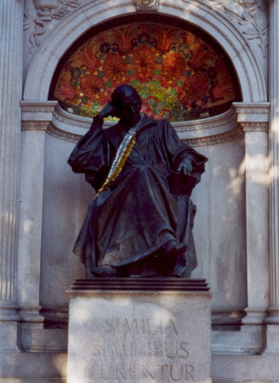
Homeopathic Remedies
FDA Draft Guidance
“Drug Products Labeled as Homeopathic: Guidance for FDA Staff and Industry”

Slide 14
Homeopathic Remedies
Attempted Repeal of Compliance Policy Guide Sec. 400.400
“Conditions Under Which Homeopathic Drugs May be Marketed”

Slide 15
Overall Community Health Challenges
Turf Battles: between professions
Innovation Banned: conventional medical standards and policies enforced
Prosecutions and Revocation of Right to Practice: punishment for practicing
Consumer Deaths: unnecessary illness and deaths
Consumer Access Denied: innovative and low risk modalities not freely accessible

Slide 16
HOMEOPATHIC APPROACH TO STRENGTHENING HOMEOPTHIC COMMUNITY
The Material Human Organism:
The Homeopathic Community
The Spirit-Like Vital Force (Dynamis):
Soul …Breath of Life…Family Bonds…
Group Consciousness… Synchronicity…
The Universe

Slide 17
Freedom Solutions
“A healthy person or community will throw off too much restriction of sovereignty in order to control their own destiny.” Diane Miller
Solution:
Control in the “least restrictive means” to the point where there is no substance left except the essence of order and harmony: “responsible freedom”.

Slide 18
Remedy Freedom
“In a harmonious community there dwells a group consciousness that animates the community persona while holding sacred and responsible the individual sovereign life experience to reign supreme.”
Diane Miller
Group Consciousness

Slide 19
Remedy Freedom
“the least restrictive means”
…where fundamental liberties are at stake.
Balance and Harmony

Slide 20
Principles of Health Freedom

Slide 21
Principle #1. The fundamental right of self-determination of individuals, to be let alone to survive on their own terms and in their own manner.

Slide 22
Principle #2. The freedom to perceive and to act as one wishes to secure health and survival.
Speak freely
Move about and associate freely
Perceive, believe, meditate, and pray freely
- Practice the healing arts

Slide 23
Principle #3 The freedom to access who and what one needs or prefers for ones health and survival

Slide 24
Principle #4 The responsibility to do no harm.

Slide 25
Principle #5 The responsibility to respectfully tolerate diverse options in health, healing, and survival choices.

Slide 26
Principle #6 The duty of corporations and institutions to be trustworthy entities upholding health freedom rights and liberties of members of the human family, and abiding by health freedom responsibilities.

Slide 27
Principle #7 And in light of the special legal nature of corporate entities and their systemic impact on the human family, the duty to:

Slide 28
#7-1 -honor and preserve the sovereign nature of individuals, the sovereignty of the United States; and avoid any negative impact on the sovereignty of other nation states;

Slide 29
#7-2 -honor and preserve American financial and cultural diversity and multicultural systems, and avoid negative financial or cultural impacts on other nation states;

Slide 30
#7-3 -avoid creating or being monopolies, and avoid the use of large monopolistic ownership of resources to dominate cultures, public policies, regulations and laws;

Slide 31
#7-4 -avoid dominant control of natural resources, avoid the suppression of access to natural resources, and avoid potentially harmful modification or destruction of natural resources; and

Slide 32
#7-5 -avoid promotion of products, protocols, policies, regulations, or laws, that would encourage unlimited dependence on corporations and institutions, or that would discourage, prohibit, or otherwise negatively impact the ability or will of humans and local human communities to survive and prosper without the corporation of institution.

Slide 33
Principle #8
The duty of the government to protect health freedom and to make no law or public policy abridging health freedom or its fundamental principles.

Slide 34
Essence of True Freedom
“Freedom is a Conversation”
Diane Miller JD

Slide 35
National Health Freedom Coalition a non-profit educational organization
PMB 218, 2136 Ford Parkway, St. Paul, MN , USA 55116-1863
www.nationalhealthfreedom.org
E-mail: similars@aol.com

